Slide 1
Exploring Collaboration Between State Data Centers and Census Bureau Research and Methodology
Ron Jarmin
Assistant Director for
Research and Methodology
U.S. Census Bureau

Slide 2
R&M 101
Former Director Dr. Groves re-formed the Research and Methodology Directorate in 2010.
Corporate-wide mission to improve existing Census products and processes and to develop new methods and products to improve economic and social measurement

Slide 3
You are our customer
Purpose of this conversation is for us to learn more about each other and learn how we can help each other do our jobs better
I’ll briefly describe some of activities that
  Span the lifecycle of the production of statistical information
  Seem particularly relevant to the SDCs

Slide 4
1. Modernization of Data Collection Activities
Adaptive Survey Design
Expanded Use of Pre-existing Data (e.g., administrative data, prior survey records)
Efficient data collection architecture
Corporate wide approach
Centered in R&M’s Center for Adaptive Design (CAD)

Slide 5
CAD Research Activities for 2012-2013
1. Assembling and assessing data requisite for adaptive design:
  Auxiliary Frame Data, Paradata, Survey response data
2. Test uses of Frame Enhancements and Paradata in Survey Management:
  Propensity models in simulation, Business rules in simulation, Business rules in the field

Slide 6
CAD Outreach and Education
Training and follow-up for survey teams
Development of custom dashboards to display key survey metrics
Work with Field on implementation issues
Publicize activities and lessons

Slide 7
Architecture Activities
Documenting our current architecture to inform where Adaptive Design can be applied (Complete in fall 2012)
Developing adaptive design overall conceptual solution architecture, as well as initial baseline architecture (Spring 2013)
Target for initial baseline is to have a functioning system in place for the 2015 American Community Survey (ACS) and the 2014 Company Organization Survey/Annual Survey of Manufacturers (COS/ASM)

Slide 8
Architecture Activities
An evolving and incremental strategy for building the solution architecture:
Each Baseline:
Will be built to put eligible surveys and censuses into production
Builds upon the previous baseline, adding or replacing functionality
Supports ongoing census and survey operations
Will inform the corresponding full lifecycle cost model
As-is Analysis
To-be Requirements
CAD Research
2017 Econ
2020 R&T
Demo Surveys
ACS
Requirements
As-is
Baseline 1
Baseline 2
Baseline 3
End-State
Build 1
Build 2
Build 3
Final Build
Approx. 18-24 months
8

Slide 9
2. Processing
Small Area Estimation
Users want data for small domains (e.g., areas, groups, industries etc)
Surveys are limited in their ability to produce such estimates directly
Models can help

Slide 10
Small Area Income and Poverty Estimates (SAIPE)
SAIPE program annually applies statistical models to ACS data to produce estimates of the number of school-age (5-17) children in poverty for states, counties, and school districts.
U.S. Dept. of Education uses these estimates to determine allocations of federal funds to school districts (about $14.5 billion in 2011).
Direct ACS poverty estimates for many small counties and school districts are based on 5 years of ACS data, leading to some lack of currency, and these 5-17 poverty estimates can have high standard errors.

Slide 11
Goals of SAIPE are to improve on the timeliness and reliability of the direct ACS estimates.
Timeliness: model 1-year rather than 5-year ACS estimates.
Reliability: SAIPE models borrow information from administrative records data – primarily IRS tax data and SNAP (formerly food stamp) program data.
R&M directorate staff have collaborated on SAIPE with staff of the Social, Economic, and Housing Statistics division (SEHSD, formerly HHES) since the inception of the SAIPE program in the mid 1990s.
The accompanying histogram shows the improvements in statistical reliability (measured by the CV = std. error / estimate) from the SAIPE county model for 2005 compared to corresponding ACS direct 1-year estimates. Note that most of the model CVs are less than half of the direct estimate CVs.

Slide 13
3. Dissemination
Traditional published tables increasingly irrelevant for many data users
Use multiple modes of data provision targeted for meet the needs of specific groups of users
  Tables (e.g., AFF)
  Traditional PUMS
  APIs
  Synthetic microdata
  Secure access to gold standard microdata (RDCs)

Slide 14
Census Bureau RDCs
Encourage knowledgeable researchers to become familiar with Census Bureau data products and collection methods in order to improve their utility and quality
Create new products that leverage the value of data that have already been collected
Address important policy questions without the need for additional data collection

Slide 15
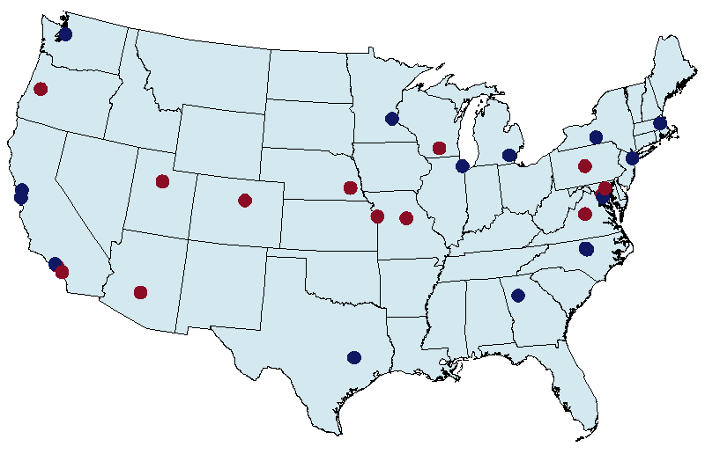
Census RDC Network

Slide 16
Role of RDC Research
Allows for linking survey and administrative data at the unit level across data sets and over time
New Estimates squeeze more value out of existing data
Enables collaboration between the Bureau and top research institutions
Enables Census to check the quality of data that it collects, edits, and tabulates.
Secure RDC environment permits rigorous analysis with micro data to uncover strengths and weaknesses in the micro data records. Permits testing validity and consequences of many decision rules covering definitions, classification, coding, processing, and disclosure..

Slide 17
Data Availability
Census Bureau Data
  Economic Data
    Establishment or firm level
    Commingled with Federal Tax Information (FTI)
  Demographic Data
    Household or individual level
    Small area geographic identifiers
  Combined Econ/Demo Data
    Longitudinal Employer-Household Dynamics
Other Agency Data
  National Center for Health Statistics (NCHS)
  Agency for Healthcare Research and Quality (AHRQ)

Slide 18
Activity at the RDCs
Current
  15 locations
  ~180 Active Research Projects
  ~600 Researchers
Future
  Additional branches and proposals for new RDCs
  Expansion of data offerings
    Administrative data
    Paradata
    Other agencies data

Slide 19
4. Data Products
Local Employment Dynamics
Partnership - States + US Census Bureau
Administrative Records + Censuses and Surveys
Public-Use Data Products
  Quarterly Workforce Indicators (QWI)
  LODES or LEHD Origin-Destination Employment Statistics
  OnTheMap and OnTheMap for Emergency Management
  http://lehd.did.census.gov/led/

Slide 20
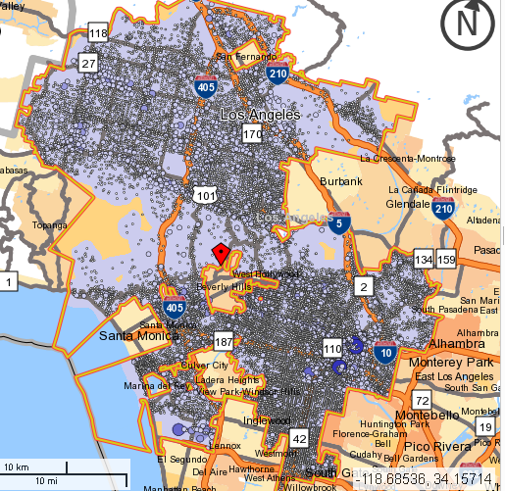
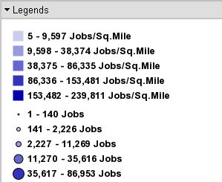
Characteristics of the Local Labor Force
Notes:
LED can be used to provide detailed information about the local labor market, such as:
who’s employed in what industry.
How high is worker turnover in specific areas and in specific industries?
Where are the jobs?
What are workers (and new hires) in a particular region and industry being paid?

Slide 21
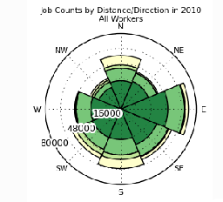
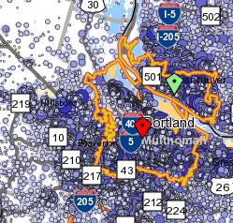
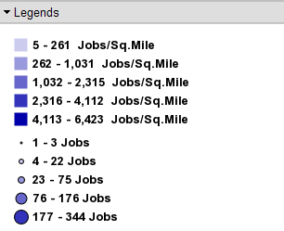
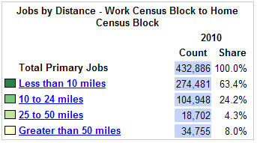
Commuting Patterns
Notes:
LED provides measures of employment by where people work as well as where they live. This information allows transportation planners to know where new roads and public transportation should be located. Because QWI measures employment over time, transportation agencies can use the trends to develop better projections of future transportation needs. These measures can also be used by community colleges and other educational institutions to identify where their potential clients live and work.

Slide 22
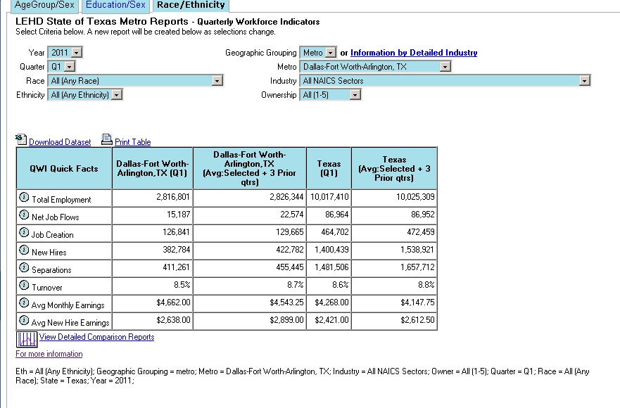
Comparison Tool
QWI
Industry Growth
Employment by Year
Employment Trends
Worker Earnings
Notes:
Employers need to know what workers are being paid, and what to pay new hires.
Workers need to know what pay they can make in different kinds of industries – and what they can make after they’ve been in the industry for a few years.
Placement agencies need to know what different types of jobs are likely to pay, and educational institutions need benchmarks so they can measure the performance of their graduates.
Economic development agencies need to tell prospective businesses what the workforce earns.
We are currently working on a new application for QWI.

Slide 23
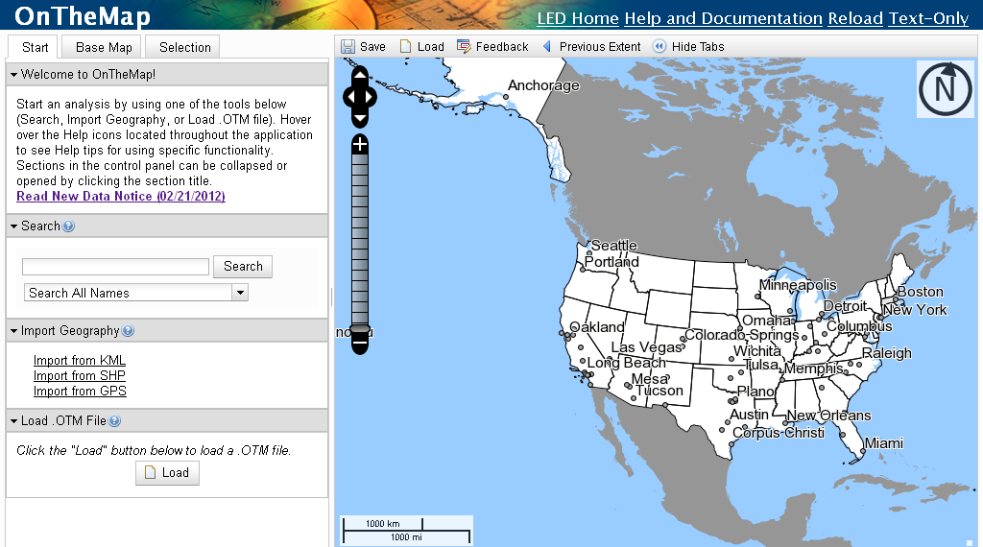
OnTheMap
Notes:
Our OnTheMap data tool is a web-based mapping and reporting application that shows where workers are employed and where they live. It also provides companion reports on age, earnings, industry, race, ethnicity, educational attainment and sex.

Slide 24
LODES
LEHD Origin-Destination Employment Statistics
  Data source
    Office of Personnel Management
  Coverage
Notes:
Data Source
Prior to the addition of Federal employment, the universe of employment data in LODES/OnTheMap was limited to jobs covered by state unemployment insurance (UI) programs. These data were sourced in UI records shared with the Census Bureau as part of the Local Employment Dynamics (LED) Partnership.
By accessing records made available through the Office of Personnel Management (OPM), the LED Partnership has been able to add data on many Federal employees into its data infrastructure and into its data products, such as LODES/OnTheMap. Differences exist between UI-sourced records and OPM sourced records and these will be detailed below.
Coverage
Due to security concerns and differences in administrative processing, not all Federal civilian employees are included in the LODES. It’s easier to mention what Departments and Agencies are excluded, such as FBI, CIA, DEA and the U.S. Military. Visit our website for a list of exclusions.

Slide 25
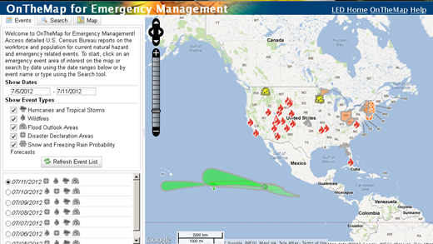
OnTheMap for Emergency Management
http://onthemap.ces.census.gov/em.html
Notes:
Version 3 is a significant upgrade and offers a number of new capabilities and data additions to assist emergency preparedness, response, and recovery activities. Important changes and improvements include:
Expanded Report Content - the addition of Decennial 2010 Demographic & Housing Characteristics; 2010 Jobs & Worker Sex Data
New Emergency Event Data - the addition of FEMA Disaster Declaration Areas & NWS Snowfall Probability Forecasts
More Complete Hurricane Archives - Capture & Archiving of all Daily NHC Storm Updates
New Analyses & Visualizations - New Reports with Charting & Thematic Map Overlays Showing Population & Worker Distributions
New Interoperability - New Tool for Exporting Event Areas to use in OnTheMap or Other GIS Applications
Updated Interface and Help Documentation - Improved User Interface Speed and Navigability; Improved Event Searching; Newly Updated Help Documentation
OnTheMap for Emergency Management Version 3 can be accessed directly by going to the following link http://onthemap.ces.census.gov/em.html.

Slide 26
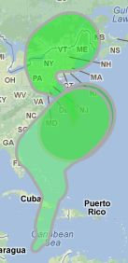
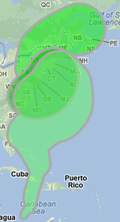
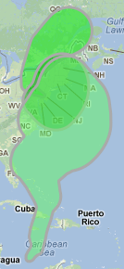
Progression of Hurricane Sandy
October 28 October 29 October 30

Slide 27
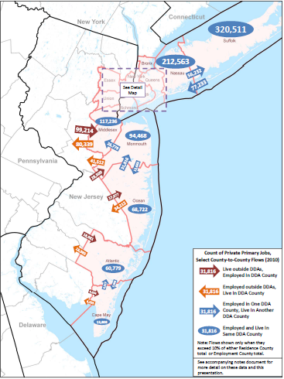
County Flows of Employment Disaster Declaration
Notes:
County Flows of Employment for Disaster Declaration Areas
(DDAs) Under DR‐4085 and DR‐4086

Slide 28
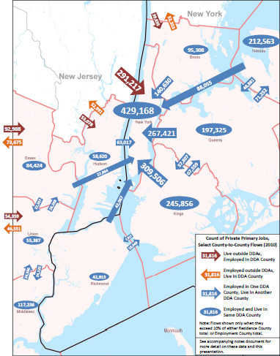
County Flows of Employment for Disaster Declaration
Notes:
County Flows of Employment for Disaster Declaration Areas
(DDAs) Under DR‐4085 and DR‐4086

Slide 29
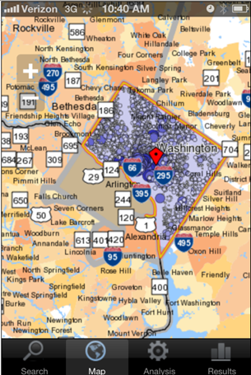
OnTheMap Mobile
http://onthemap.ces.census.gov/m
Notes:
LEHD released Version 6.1 of OnTheMap application in June. A major new feature of this release is OnTheMap Mobile, a mobile-optimized version of OnTheMap that can be accessed through mobile (IOS and Android) web browsers. OnTheMap Mobile can be accessed directly at http://onthemap.ces.census.gov/m/.
According to Tim Reis of Google, Mobile is mainstream.
OnTheMap Mobile is a touch-based web tool that shows where people work and where workers live.
It has the same capabilities as the standard OnTheMap functionalities, which is easy access to maps, charts, and reports on your mobile device from your current location.
This touchscreen interface was developed specifically for smartphones and tablets. Other mobile devices can utilize our text-only tool.

Slide 30
Questions?
Ron.S.Jarmin@census.gov
www.census.gov/research

