Slide 1
Northwest Census Research Data Center (NWCRDC)
Mark Ellis
Director, Northwest Census Research Data Center (NWCRDC)
Director, Center for Studies in Demography and Ecology (CSDE)
Professor of Geography
University of Washington, Seattle.
ellism@uw.edu

Slide 2
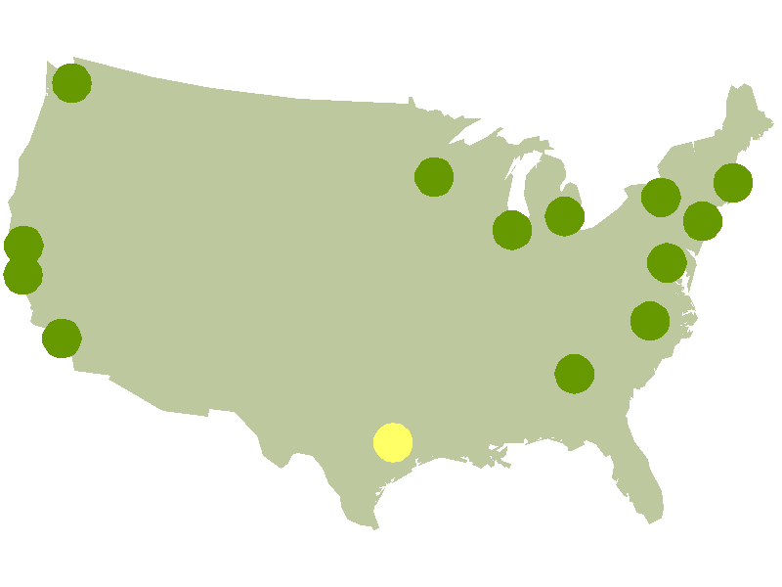
What is the NWCRDC?
Part of a network of Census Research Data Centers
NWCRDC is the most recent to open (June 2012): http://depts.washington.edu/nwcrdc/
Atlanta Boston California, Berkeley California, Los Angeles California, Stanford Census Headquarters Chicago Michigan Minnesota New York, Baruch New York, Cornell Northwest Texas (Coming Soon) Triangle, Duke Triangle, RTI International

Slide 3
What are RDCs?
RDCs provide secure access to restricted-use microdata from a range of federal agencies
Census Bureau, IRS, National Center for Health Care Statistics, etc
Qualified researchers with approved projects can conduct research in RDCs that benefits Census Bureau programs
RDCs operate as joint partnerships between a host institution (university or research organization) and the Census Bureau
RDC network is managed by the Census Bureau’s Center for Economic Studies: http://www.census.gov/ces/index.html
On site RDC administrator is a Census Bureau employee paid by the host institution
NWCRDC administrator: Mike Babb (babbm@uw.edu)

Slide 4
What is available in restricted access or non-public data?
Access to full population samples (e.g. full ACS or census 1 in 6 long form data)
Access to microdata not released in any public version
No top coding (e.g. income)
Much finer geographies (e.g. microdata by census tract)
Ability to link observations via non public link keys to create new datasets
Can link external data source to restricted data through geography, address matching etc

Slide 5
Sample data sets
Demographic
e.g. American Community Survey, Decennial Census, SIPP, NLS etc
Economic
e.g. Census Survey of Manufactures, Census of Services, Commodity Flow Survey etc
Linked Demographic and Economic
e.g. LEHD
Public Health
e.g. National Health Interview Survey, National Health and Nutrition Examination Survey, National Longitudinal Mortality Study, Medical Expenditure Panel Study etc
Go here for more information on data:
http://www.census.gov/ces/dataproducts/index.html
http://depts.washington.edu/nwcrdc/data
http://www.ciser.cornell.edu/NYCRDC/census_data.shtml

Slide 6
Technical details: how do RDC provide access?
Thin clients - encrypted VPN to secure servers at the bureau
Linux OS, with SAS, Stata, R, etc
No downloads possible, nothing stored locally
No printing unless RDC admin is present and printouts can never be removed
No laptops, cameras in the lab
To release output researchers submit completed analyses for disclosure review to ensure confidentiality is maintained
24/7 access with keycode for door entry and security system
Researchers can work when they want without administrator present
Researchers can only use datasets requested in their proposal
Can only use requested data for the purposes outlined in the proposal for the specified length of the project

Slide 7
Procedures for accessing an RDC
Contact RDC administrator, discuss idea
Submit preliminary proposal
Outline idea
Specify datasets needed, show clear need for restricted-use data
Outline benefits to the bureau – more on this in upcoming slide
Follow preliminary proposal template
Preliminary proposal will be fine-tuned based on local RDC input then passed onto Census for evaluation
Full proposal development
10-15 single-spaced page proposal outlining problem, science, need for data
Predominant purpose statement describing how project will benefit bureau
Submitted through CES website
Submit proposal, apply for Special Sworn Status (security clearance)
Aim is for proposals to be reviewed in 90 days; those using FTI require IRS review which takes (sometimes much) longer

Slide 8
Useful links
CES proposal writing webpage with templates and guidelines for writing preliminary proposal, full proposal and benefits/predominant purpose statement:
http://www.census.gov/ces/rdcresearch/howtoapply.html
Sample proposals and benefits statements are available here:
http://www.ciser.cornell.edu/NYCRDC/sample_proposals/sample_proposals.shtml
Always consult with your RDC administrator beforehand

Slide 9
Benefits
Title 13 US Code requires any access to confidential data benefit the bureau’s data collection programs
These 13 possible benefits – need to pick one or more – are the predominant purpose of RDC research (first five):
Evaluating concepts and practices underlying Census Bureau statistical data collection and dissemination practices, including consideration of continued relevance and appropriateness of past Census Bureau procedures to changing economic and social circumstances.
Analyzing demographic and social or economic processes that affect Census Bureau programs, especially those that evaluate or hold promise of improving the quality of products issued by the Census Bureau.
Developing means of increasing the utility of Census Bureau data for analyzing public programs, public policy, and/or demographic, economic, or social conditions.
Conducting or facilitating Census Bureau census and survey data collection, processing or dissemination, including through activities such as administrative support, information technology support, program oversight, or auditing under appropriate legal authority.
Understanding and / or improving the quality of data produced through a Title 13, Chapter 5 survey, census or estimate.
etc.

Slide 10
Health care data – some differences in procedure
Projects using public health data
National Center for Health Statistics (NCHS) data
Go here for details on application:
http://www.cdc.gov/rdc/B2AccessMod/ACs220.htm
No benefits statement
Contact and work with NCHS staff to ensure successful proposal
Work with Agency for Health Care Research (AHRQ) data
Go here for details on application
http://meps.ahrq.gov/mepsweb/data_stats/onsite_datacenter.jsp
No benefits statement
Contact and work with AHRQ staff to ensure successful proposal

Slide 11
Getting research out – disclosure process
Researcher writes a report describing research outputs requested, listing variables, and models, how they were estimated or constructed
Some key issues:
Cell sizes for categorical variables in models
Tabular output can be a problem (cell size, amount of data, etc) and is discouraged, but it can be requested
Models, tables, based on small groups in small areas may lead to numbers below disclosure threshold – output will be blacked out
Model estimates based on cell counts below threshold will be reported with significance and sign only
Complementary disclosure issues
Prior release
Public data
It may take time to get your results out, especially if the risks are high

Slide 12
NWCRDC access and fee policies
UW researchers without grants get access without fees
UW researchers with grants pay $20000 a year for a seat (assumes about 40% time – roughly 2 days a week on average).
Exception: those with NSF grants pay before Sept 2014
UW grad students get access without fees, must apply with adviser/faculty member
OFM users gets access for one year from opening
All other users pay fees – typically $20000 a year per seat, can be prorated, but minimum fee is $10000
More information at NWCRDC website:
http://depts.washington.edu/nwcrdc/

Slide 13
These people, institutions made the NWCRDC possible
UW
College of Arts and Sciences
Associate Dean of Research, Steve Majeski
Associate Dean of Social Science, Judy Howard
Dean Ana-Mari Cauce
School of Social Work
Associate Dean for Research, David Takeuchi
Dean, Edwina Uehara
Central Administration
Vice-Provost for Research, Dave Eaton
State of Washington
Office of Financial Management, Marc Baldwin
National Science Foundation
THANK YOU!

Slide 14
My own experience as an RDC user as an illustration…
Two RDC projects – both requiring extra sample size and census tract information from census long form data
Segregation at work and home for immigrants and US-born racial and ethnic groups
Urban geography and segregation of mixed-race couples
Both conducted at UCLA RDC, with some revisions at Berkeley RDC
Both with parallel submissions to NSF/Russell Sage Foundation for support and to RDC for access
For both, RDC proposal was a slightly modified version of NSF/RSF proposal with an additional 2-3 page benefits statement
NSF/RSF review and funding decision faster than RDC approval
My impression is that our RDC reviews were problematic – slower - in both cases because we wanted lots of tabular and mapping output in addition to model estimates

Slide 15
My own experience as an illustration…
We used the uncertainty about mapping output – which is really table output – in our benefits statement.
We explored ways to release mapping output that minimized risk of disclosure – a benefit under criterion 6 (Leading to new or improved methodology to collect, measure, or tabulate a Title 13, Chapter 5 survey, census or estimate).
Other benefits too : criterion 5 (understanding and or improving data…) – how do new census race categories affect segregation measurement; criterion 11 (Preparing estimates of population and characteristics of population…) – how to count mixed-race households under new census race categories
Some maps…
www.mixedmetro.com
Sample disclosure request memos
http://sdrv.ms/MYNNm0
http://sdrv.ms/ROtlLm

