Slide 1
Geographic Support System Initiative (GSS-I) Update
Andrea Grace Johnson
Geography Division
U.S. Census Bureau

Slide 2
GSS-I Partner Data Acquisition
Partnership Coverage (cumulative) | #
Number of partners contacted (so far…) | 486
Number of partners that provided files | 327
Number of partners that could not provide files because of use agreement or fee restriction | 14
Census Tracts covered | 31,123
Notes:
Currently we have ~38% of the population and housing covered by the files we have acquired and processed through the GSSI in FY 13 and 14.
Of the partners that we have contacted 305 – or 65% have provided files, and 14 – or 3% cannot provide files.

Slide 3
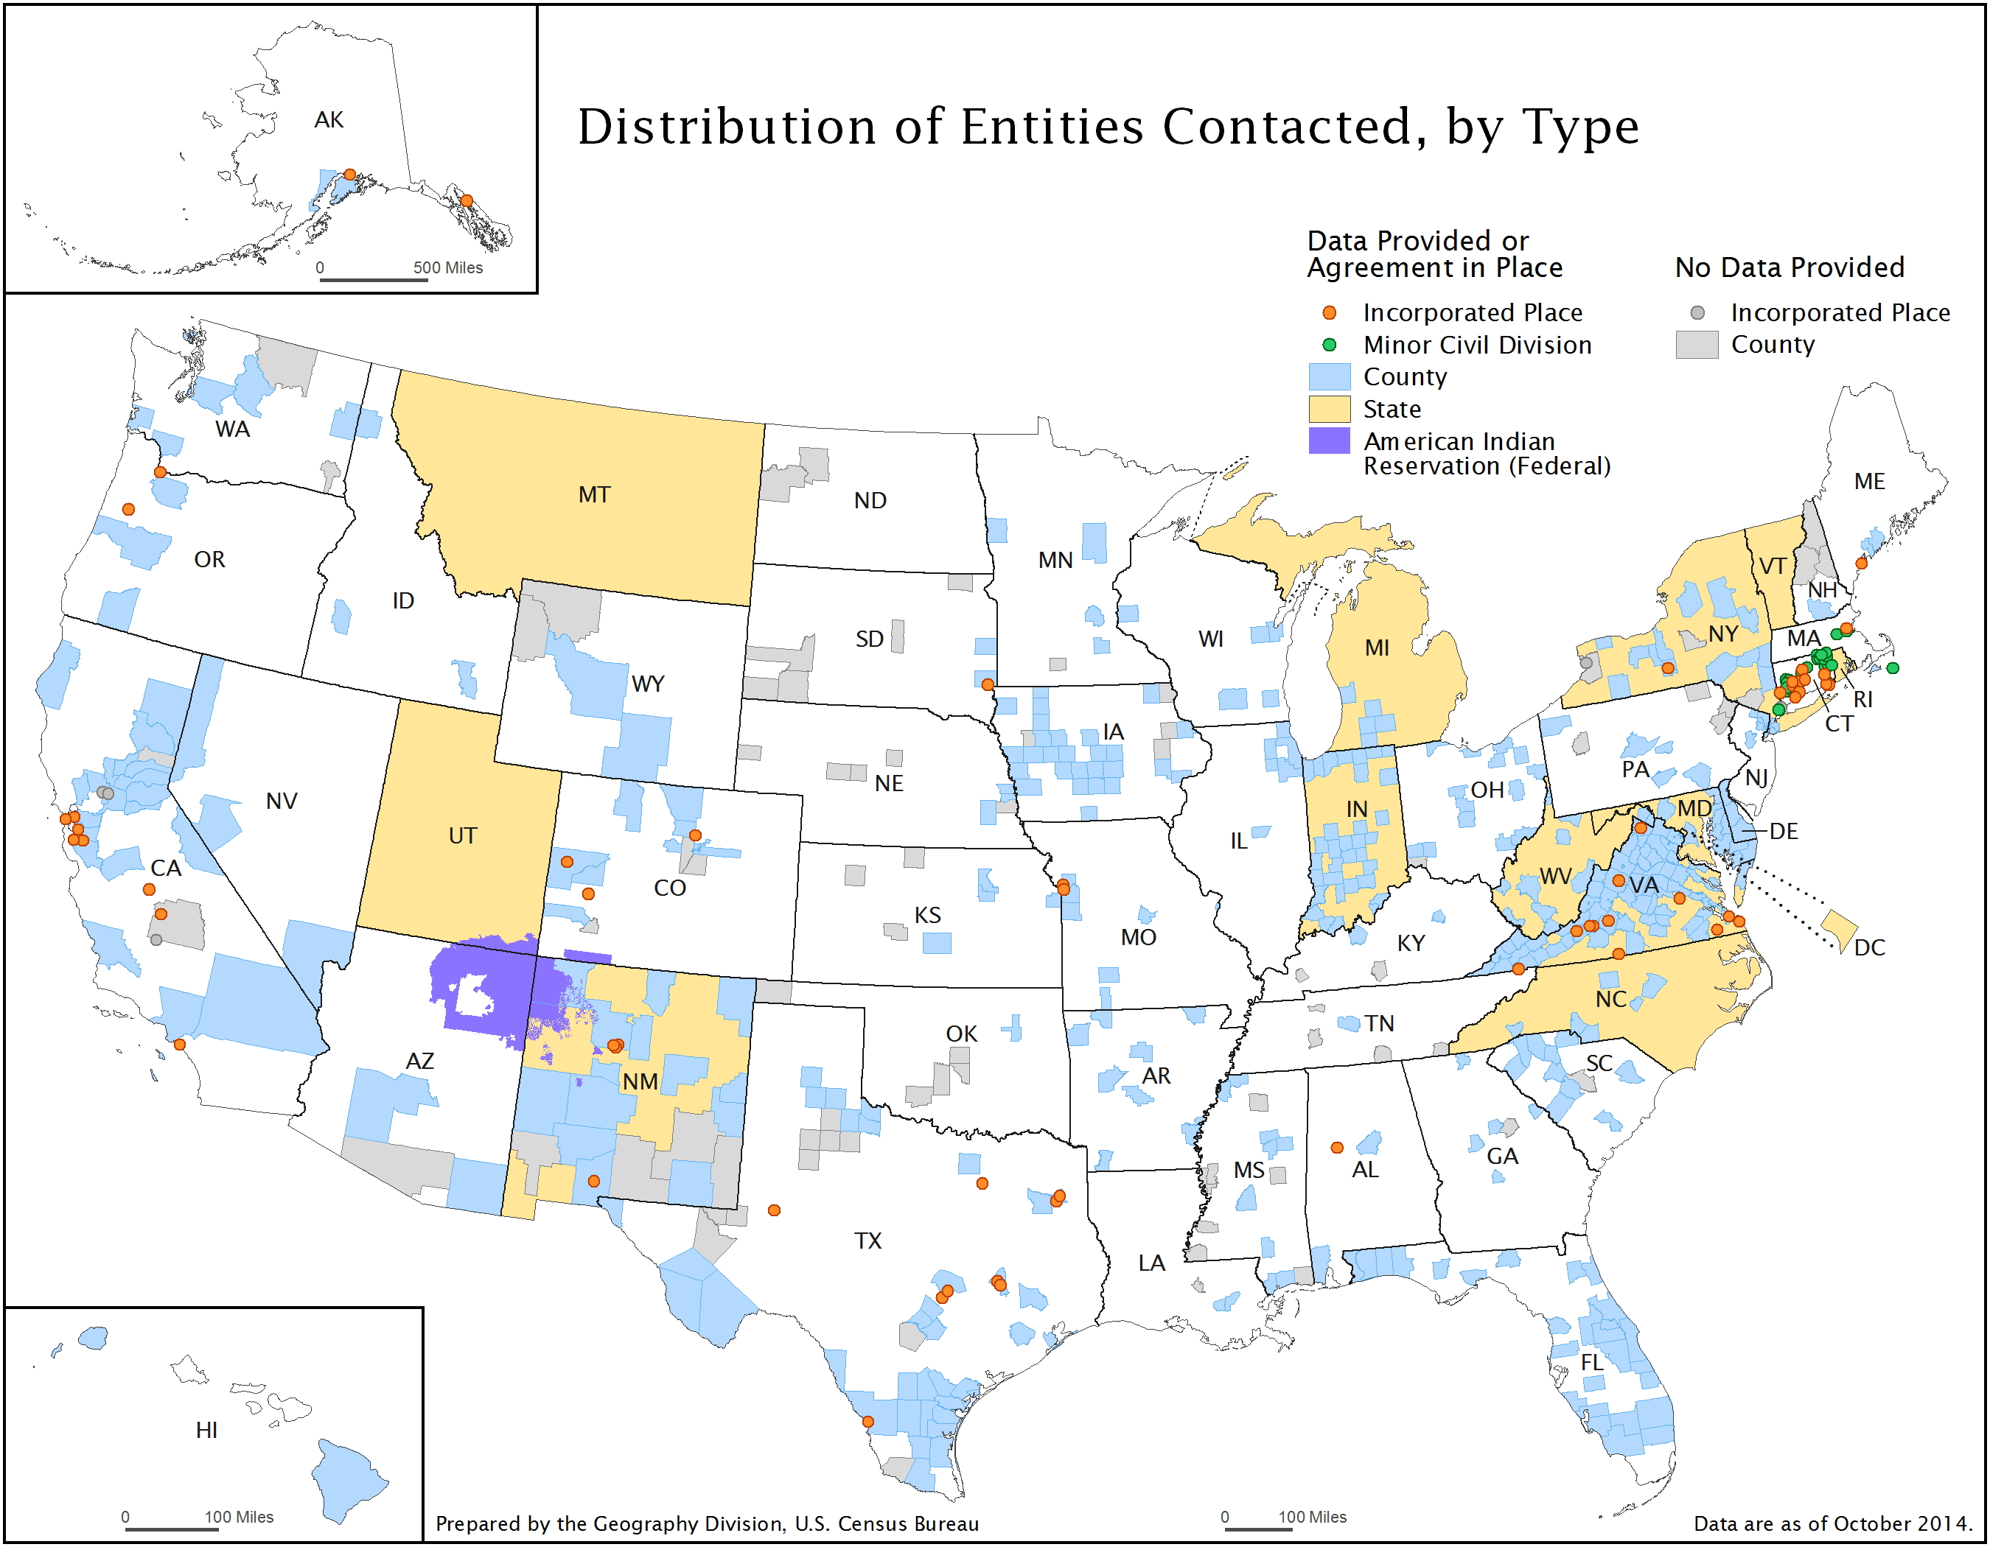
Notes:
This map not only shows coverage it shows the impact of working with the states to collectively obtain data from governments within the state.
For States with agreements which have areas that could not provide data, the State needs to be our advocate to help coordinate the data collection process and to communicate back to the Census Bureau as to why there are difficulties in providing data to us.
For Vermont we were able to acquire data for the entire state at the same time and process all of the data in one submission – this is ideal for the GSS-I
For New Mexico we worked with the state to obtain coverage where we didn’t have it, and while many counties were successfully uploaded not all counties had complete coverage therefore we are still missing some counties, but working with the state greatly improved our coverage and we were able to learn which counties don’t have the data we need.
In Pennsylvania, working directly with the counties, we were able to acquire data for some counties but not all counties we reached out to – here State coordination could be helpful to help us determine where we can and can’t acquire counties

Slide 4
GSS-I Address Processing
Total Partner Addresses Received (9/03/14) | 40,435,591
Total Partner Addresses Matched to Master Address File (MAF) | 34,884,631 |  | 86% of Total
Addresses in Same Block as MAF |  | 32,589,844 | 93% of Matched
Addresses in Different Block than MAF |  | 1,782,125 | 6% of Matched
New Geocode Attained |  | 492,573 | 1% of Matched
Addresses w/ No Address Class Identified |  | 18,517,760 | 53% of Matched
Total Partner Addresses Unmatched to MAF | 5,550,965 |  | 14% of Total
Unmatched Class Residential |  | 1,320,507 | 24% of Unmatched
Unmatched Commercial/Other/ Unspecified |  | 4,230,458 | 76% of Unmatched
Notes:
We originally received 42 million addresses but identified 1.6 duplicates in this data prior to processing it.

Slide 5
How can you help?
Encourage partners to include the following in their address list development:
  Address Types (e.g. residential, commercial, government etc.)
  Within Structure Identifiers (e.g. apt #101)
  Identification of Group Quarters
Notes:
These improvements will make LUCA easier --

Slide 6
GSS-I Sample Feedback Reports
Figure 1. Detailed Feedback Report Sample for Florence Co South Carolina
(A) State | (B) County | (C) Tract | (D) Block | (E) GEOID | (F) Total Addresses | (G) Total Residential | (H) Total Nonresidential | (I) Total Other | (J) Total Matched | (K) Total Added | (L) Total Coordinates Added | (M) Total Not Accepted | (N) Total Not Accepted Duplicate | (O) Total Not Accepted Incomplete | (P) Total Not Accepted Other | (Q) Total Currently in MAF
45 | 041 | 1.01 | 1000 | 450410001011000 | 5 | 0 | 1 | 4 | 4 | 0 | 3 | 1 | 0 | 0 | 1 | 0
45 | 041 | 1.01 | 1001 | 450410001011001 | 8 | 0 | 0 | 8 | 5 | 0 | 0 | 3 | 0 | 0 | 3 | 1
45 | 041 | 1.01 | 1002 | 450410001011002 | 21 | 1 | 0 | 20 | 10 | 0 | 10 | 11 | 1 | 0 | 10 | 2
45 | 041 | 1.01 | 1003 | 450410001011003 | 0 | 0 | 0 | 0 | 0 | 0 | 0 | 0 | 0 | 0 | 0 | 0
45 | 041 | 1.01 | 1004 | 450410001011004 | 0 | 0 | 0 | 0 | 0 | 0 | 0 | 0 | 0 | 0 | 0 | 0
45 | 041 | 1.01 | 1005 | 450410001011005 | 89 | 19 | 2 | 68 | 38 | 0 | 28 | 51 | 0 | 3 | 48 | 38
Figure 2. Summary Address Report Sample for Florence Co South Carolina
Column | Address Data Submitted to the Census Bureau | Total
F | Total Addresses | 64,929
G | Total Residential Addresses | 51,852
H | Total Nonresidential Addresses | 277
I | Total Other | 12,800
 | Address Actions taken by the Census Bureau
J | Total Matched | 51,002
K | Total Added | 24
L | Total Coordinates Added | 44,953
M | Total Not Accepted | 13,866
N | Total Not Accepted Duplicate | 1,389
O | Total Not Accepted Incomplete | 537
P | Total Not Accepted Other | 11,940
Q | Total Currently in MAF | 61,500
Notes:
We have sent feedback to partners in most of the states you saw on the map earlier, however we are still working on automated feedback methodologies and therefore we have still not sent feedback to or MT, WA, WY, TX, UT and we are working on these and these should be available later this fall.
Each GSS-I partner receives: a “Thank You” letter, a Detailed Feedback Report, and a Summary Address Report. This slide shows an example excerpt from the Detailed report (Figure 1 on the top) and Summary report (Figure 2 on the bottom) for Florence County, SC.
After processing is complete, each GSS-I partner receives the following:
“Thank You” letter
Detailed Feedback Report
GSS-I Summary Address Report
Incorporated the RO and WAH geographers in the initial review of the GSS-I feedback products
Total partners provided feedback to date = ???

Slide 7
FY2015 GSS-I Plans
Acquire and process medium and large urban areas with suspected growth.
Continue efforts to streamline GSS-I data evaluation:
  Improve address matching
  Conflate spatial files
Work with 2020 Address Canvassing Groups to align GSS-I file acquisition with 2020 Census design.
Notes:
Areas such as (but not limited to)
Cook Co IL,
Miami Dade, FL
Philadelphia, PA

Slide 8
SDC’s and the GSS-I
Join us as we work to coordinate efforts amongst all groups working with state and local geospatial data:
  State Data Centers (SDCs),
  National States Geographic Information Council (NSGIC),
  Federal-State Cooperative for Population Estimates (FSCPE),
  Census Bureau
Coordination may include:
  Identifying where address or road data does not exist,
  Identifying owners of address and geospatial data in your state, and sharing this information between our groups.
  Participating in Census sponsored webinars to discuss topics like partner file status, data issues, future directions etc.

Slide 9
Thank You!
Contact me:
  Andrea.Grace.Johnson@census.gov
We couldn’t do this without our partners!

