Slide 1
American Community Survey briefing on messaging and mail package assessment Research State Data Centers & Census Information Centers Steering Committee
Shelley Walker, ACSO
October 22, 2014
Notes:
Purpose:
To address frequent questions and concerns we hear about the ACS surrounding privacy, intrusiveness, value of the data, and burden of completion
Contractor – Team Reingold (Reingold, Inc.; Penn Schoen Berland; Decision Partners)

Slide 2
Research Goals
Primary: Develop and test messages and mail package refinements to increase ACS self-response rates
Secondary:
Apply insights from ACS message testing to support general outreach, data dissemination, materials development, and call center and field operations
Help inform the 2020 Decennial Census Communications Campaign
Notes:
What is the current self response rate?

Slide 3
Research Overview: Project Phases
Messaging Research
December 2013: Mental models interviews with internal stakeholders
January 2014 – February 2014: Key informant interviews with stakeholders
January 2014: Deliberative focus groups with stakeholders who are distrustful of the government
January 2014 – February 2014: Message testing - Benchmark survey
March 2014 – April 2014: Message testing: Refinement survey
Mail Package Assessment
May 2014: Creative design of mail package alternatives and messages to test
June 2014 – July 2014: Focus groups and one-on-one interviews
September 2014: Quantitative online visual testing
Field Test – To be conducted by ACSO during or after Fall 2014, budget pending

Slide 4
Messaging Research Deliberative Focus Groups
Conducted focus groups in seven cities (emphasis was on recruiting participants from low-response areas):
Albuquerque, NM
Atlanta, GA
Dallas, TX,
Los Angeles, CA - conducted in Spanish with Spanish speakers
Richmond, VA
St. Louis, MO
Washington, DC
There were 24 to 28 participants in each group
Cities represented diversity in their geographic and racial composition

Slide 5
Key Messaging Research Findings
Key Findings across Initial Research
America knows Census – but not ACS
Perception of “irrelevant” or unnecessary questions raise concerns about privacy
People believe the government already has the personal information ACS collects
Distrust of government is pervasive
Participants frequently evaluated the ACS in terms of tangible, community-level benefits - “Community” is key
People for whom English is not their first language face unique barriers to response
Ensure that when interacting with respondents, the field representatives have the right materials and messages
People value convenience and choice in response options

Slide 6
Mail Package Assessment Research Phase
Create designs of mail package alternatives and messages to test:
May 2014
Mail Package Cognitive Interviews:
June 23, 2014 – July 2, 2014
Online Visual Testing:
September 5, 2014 – September 19, 2014

Slide 7
Review of Mailing Packages
Independent Expert Input
Don Dillman (external SME) reviewed the alternate mail designs and provided us with his feedback
Agrees with Reingold (contractor) that we should eliminate the prenotice letter and simplify the paper questionnaire mailing
Strengthen the cover letter mailing and communications across the mail pieces about the mandatory request
Notes:
Notes:
When I considered your current pre-notice I did not get the impression that it is very effective for improving response in ways that will build a compelling argument for responding to that later request for responding over the Internet. No mention is made of the response being mandatory. The letter is not from a person, which makes it an obvious sign of being unimportant. In addition the letter is not dated (another sign of unimportance). Although the letter has an inside address, it seems strange that the line that follows it reads, “A message from the Director, U.S. Census Bureau.” Culturally, that signals that the message is unimportant. Finally, there is no signature at the bottom of the letter.
I would redesign the current second mailing in a significant way. I would integrate the content of the first and second mailings and probably use a folded card with the address printed in its current position, where I would provide complete instructions on use of the url and id numbers, getting them into a more logical order. I would also rework the cover letter to emphasize why this survey is being done, the importance of doing it online, etc.

Slide 8
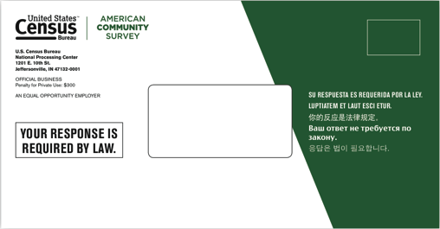
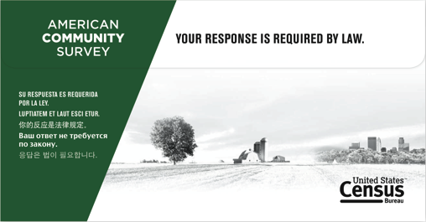
Theme 1: “Official”
Envelope
Front
Back

Slide 9
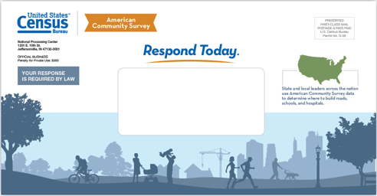
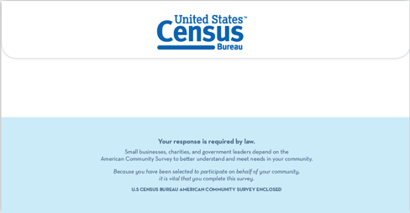
Theme 2: “Community”
Envelope
Front
Back

Slide 10
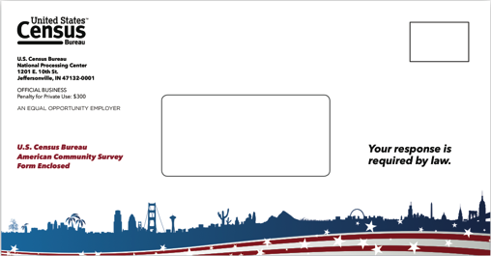
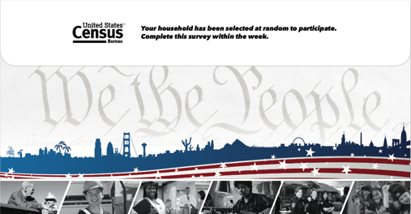
Theme 3: “Patriotic”
Envelope
Front
Back

Slide 11
Mail Package Assessment Focus Groups
Conducted six focus groups with a broad range of participants (emphasis was on recruiting participants from low-response areas):
Chicago, IL
Fresno, CA
Miami, FL - conducted with bilingual English-Spanish speakers
New Orleans, LA
New York NY
Phoenix, AZ
Each group was 90 minutes long – approximately 10 participants
Cities represented diversity in their geographic and racial composition

Slide 12
Key findings from the mail package assessment
The current package was seen as most effective
Consider a hybrid of effective design elements
The ACS name does not register
“Punitive" messages resonate more than "altruistic" messages.
Notes:
Notes:
1.The existing ACS design was most frequently reported to be the most effective package. This design conveyed a strong sense of being official, important, and from the government, which participants deemed more essential than being attractive, colorful, or “friendly.” Alternative packages were frequently seen as appearing too “commercial.”
2. Still, based on positive responses to certain elements of other designs, it is clear that the current package presents a number of areas for improvement, for consideration in further testing and revisions to the package design. Effective tactics to consider include using visual hierarchies to call out important messages, demonstrating local community benefits more clearly, rethinking the design of reminder postcards, incorporating “Keep this card” messaging, developing more engaging and streamlined brochures, and using alternative color schemes.
3. Surprisingly, the concept of the “American Community Survey” barely registered with participants, despite long conversations about the mail package designs. Lacking prior awareness of the ACS, participants frequently thought the ACS designation was not essential to their understanding of the package and commonly conceived of the mailing as “a census survey” or confused it with the decennial census.
4. A more punitive, “stick” approach to messaging resonated foremost with participants. However, more altruistic “carrot” messages — especially those about local community benefits — were an effective complement and offered participants a reason to want to complete the survey.

Slide 13
Online Visual Testing
Uses three web-based exercises to identify key information about the designs:
Mail stack exercise: an interactive simulation of mail sorting
Image click analyzer (heat map): asks respondents to click on design elements, illustrating what attracts attention
Message highlighting: asks respondents to highlight words and phrases that they find compelling

Slide 14
Key findings from the Online Visual Testing
Visual design elements and deadline messaging can have a significant impact on how people read and remember mail items
The U.S. Census Bureau logo should be prominently featured on mail items

Slide 15
Key findings from the Online Visual Testing
Key words and phrases in letters should be emphasized using callout boxes, line spacing, and bolded text
“Your response is required by law” attracts more attention than any other message
It is possible to overdo the commercial “marketing” look and feel

Slide 16
Reports
The following reports are final:
Mental Models Interviews with Internal Stakeholders
Key Informant Interviews with Stakeholders
Deliberative Focus Groups with Stakeholders
Message Testing: Benchmark Survey
Message Testing: Refinement Study
Mail Package Research
Access reports at:
http://www.census.gov/acs/www/library/by_year/2014

Slide 17
Next Steps - Field Test
Census Bureau will receive recommendations – October 2014
Census Bureau will develop and implement field tests – Fiscal Year 2015, budget pending
Census Bureau will analyze and determine final recommendations for program implementation– Fiscal Year 2015

Slide 18
Questions?

