Slide 1
Changes of the American Community Survey State Date Center and Census Information Center Steering Committees
Tasha Boone
October 22, 2014

Slide 2
Contents
Budget
Current ACS Challenges
Messaging and Mail Package Assessment Research
Content Review
Followup Operations
Products and Materials
Data Users Group
Performance Management

Slide 3
Budget
The ACS budget is determined each year by Congress
Total Allocated for Fiscal Year 2014: $230.6 million
Data Collection Costs: $174.3 million
Internet and Mail - $38.1 million
Telephone Interviews - $21.5 million
Personal Interviews - $99.4 million
Group Quarters - $15.3 million
FY 15 President’s budget request: $245.8

Slide 4
Current ACS Challenges
Issue Congressional Discussion
Burden
Intrusiveness Defund or Eliminate Survey
Harassment
Mandatory Voluntary
Penalties Reduce or Eliminate Survey

Slide 5
Messaging and Mail Package Assessment Research
Why we started this research
Goals of project:
Develop and test messages and mail package refinements to increase ACS self-response rates
Apply insights from ACS message testing to support general outreach, data dissemination, materials development, and call center and field operations
Help inform the 2020 Decennial Census Communications Campaign

Slide 6
Content Review
Content Review process started in early 2013
2014 ACS Content Review builds upon earlier efforts begun during the comprehensive ACS Program Review to…
Examine and confirm the value of each ACS question
Confirm and update the legal basis for questions
Gather input from federal agencies and other data users
Analyze data using pre-specified criteria established by the ACS Subcommittee of the Interagency Council on Statistical Policy (ICSP)
Develop recommendations for ACS content that will provide the most useful information with the least amount of burden to the public
The public will have the opportunity to respond to the recommendations for removal via the Federal Register notice published in October

Slide 7
Follow Up Operations
Completed research to reduce contacts during telephone follow up
Reduced contacts from 25 to 15 calls
Planning research to explore reducing person follow-up contacts with respondents
Effects on the estimates at small levels of geography from having fewer contacts
Effects on the CAPI and survey response rates at smaller levels of geography

Slide 8
Products and Materials
Improving usefulness of our outreach data products and materials
Collecting ACS use cases to use as examples to illustrate ways ACS data is used
Use lessons learned from MMPAR to develop new ACS outreach materials that resonate with respondents and the public
ACS hopes to use Team Reingold to develop their materials in FY 2015

Slide 9
Data Users Group
Established the ACS Data Users Group
Improve understanding of the value and utility of ACS data and to promote information sharing among data users about key ACS data issues and applications
Conduct webinars and special sessions at professional meetings
Host ACS data users conference
Create users group website and online community

Slide 10
Performance Management
Performance Management is the use of performance measures by managers and leaders to inform decisions about how best to achieve the organization’s mission and strategic goals
Notes:
Performance Management is the use of performance measures by managers and leaders to inform decisions about how best to achieve the organization’s mission and strategic goals. In other words, we measure performance in order to manage performance (for the program).
The emphasis on decision making is why we use the term ‘Performance Management’ rather than ‘Performance Measurement.’
Performance measures, without deliberation, decision-making, and action, are a misuse of valuable resources and should be avoided.
Because Performance Management is about decision-making and action, defining the governance structure around Performance Management is an important first step. Understanding who needs to make what decisions will help shape which measures should be prioritized for reporting. Understanding the decisions that need to be made will also help define the level of detail and reporting frequency of the measures.

Slide 11
Benefits of Performance Management for ACS
Establishes and communicates a baseline view of organizational performance
Provides an understanding of what the program is doing well
Identifies potential areas to improve effectiveness and efficiency of current operations
Improves the program’s ability to communicate performance to stakeholders
Collectively, all benefits above increase the transparency of the program’s efforts
Provides a structure for responding to changes in the environment
Notes:
As a survey program, most of the measures that ACS reports on were aimed at the quality of their survey. They didn’t generally use those measures to manage the execution of the program. Also, the measures didn’t help them fully convey the real value of the program and the complexity of executing it to balance competing values (e.g., survey quality v. respondent burden).
[Question to pose to audience: “What program have you worked on that hasn’t had increased oversight?”] The benefits of performance management, particularly in the context of a comprehensive performance framework, include meeting those increased oversight requirements and showing the value of the program to stakeholders.

Slide 12
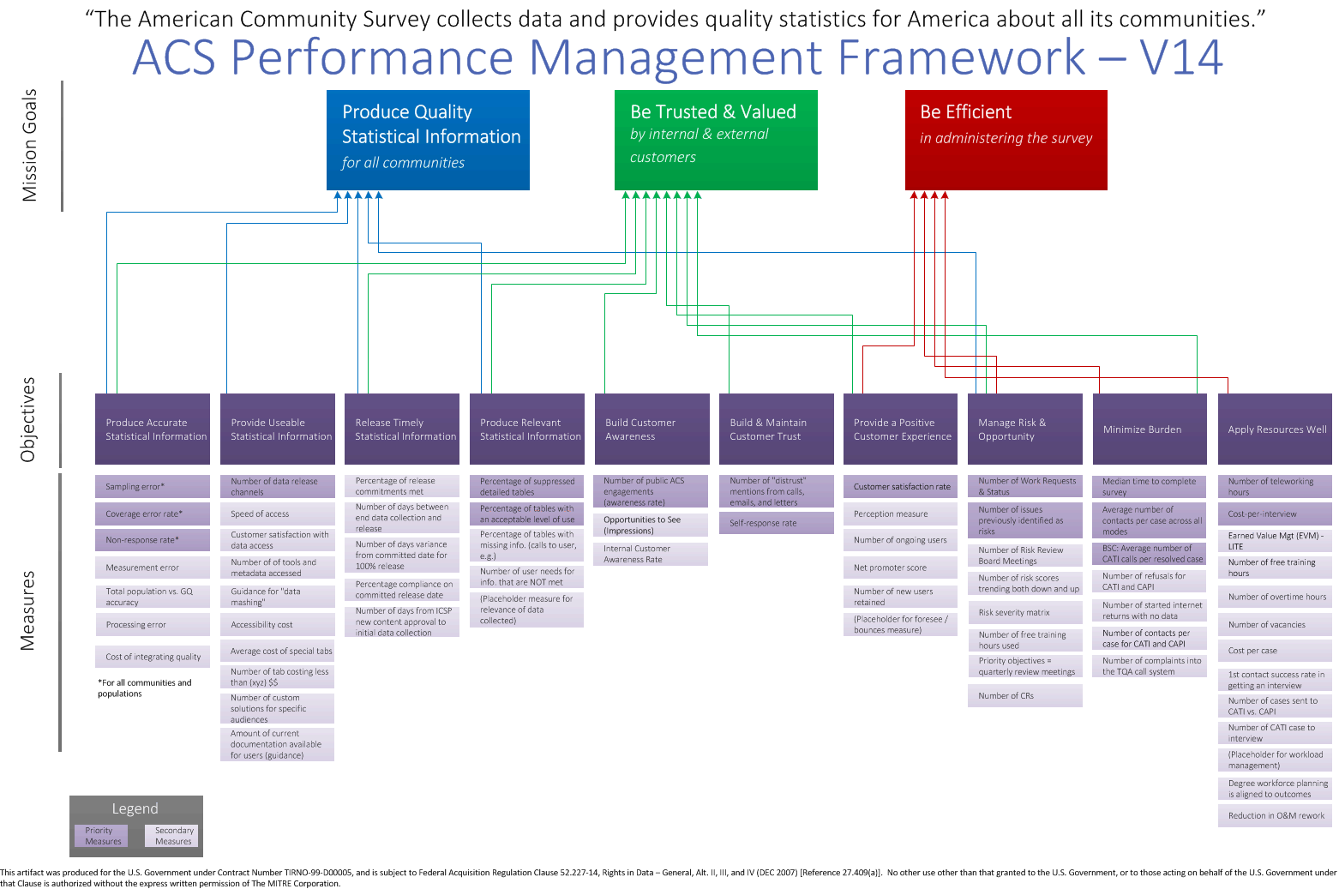
Notes:
And here is the ACS Performance Framework.
As you can see, ACS has three (3) enduring mission goals decomposed into 10 Mission Objectives (dark purple). The ACS Senior Staff initially identified what it believed to be appropriate measures for each of the 10 mission objectives in a brainstorming session. Because they did not want to overload the ACS staff, they prioritized a subset of those measures for initial implementation.
ACS originally had identified 21 priority measures for initial development (out of a total of 52), but then deprioritized some based on early discussions with staff regarding constraints (e.g., data availability) and relative value add.
The darker lavender color highlights the 17 measures currently prioritized (out of a total of 66) for reporting.

Slide 13
Next Steps for ACS Performance Management
Continue to refine and iterate ACS Performance Measures as appropriate
Mature the Performance Management capability
Document the Performance Management Process
Initiate an annual Performance Management Framework and Process review (next review – Jan 2015)
Continue to engage stakeholders interested in ACS program performance
Establish an annual review of work done in relationship to the program, drawing from both portfolio management and performance management
Notes:
In the spirit of effective performance management, ACS will continue to learn and refine as it goes (i.e., iterative process) —through the regular performance reviews and through a formal annual cycle of reviewing the framework and the process.

Slide 14
Stay Involved!
For the latest ACS updates, visit:
http://www.census.gov/acs/
Sign up for GovDelivery ACS Subscriber Notices:
https://public.govdelivery.com/accounts/USCENSUS/subscriber/new

Slide 15
Questions?

