Slide 1





U.S. Census Bureau Economic Census
SDC Annual Conference
April 10, 2018
April 2018

Slide 2
Opening Remarks
Kimberly P. Moore
Survey Director for the Economic Census
Chief, Economy-Wide Statistics Division
U.S. Census Bureau
April 2018

Slide 3
Agenda
Economic Census Overview
Promoting Response
Example Partner Briefing
How You Can Help
Preview of Videos
Q&A
April 2018

Slide 4

The Economic Census
Measures U. S. businesses every 5 years
Covers employer businesses in 18 industrial sectors
Implements the North American Product Classification System (NAPCS)
Online Response is required
April 2018

Slide 5

Economic Census Dates
Classification letter mailed February 1
  Due March 15
Long form letter mailing May 1
  Due June 12
Data available starting September 2019
Data releases completed by December 2021
April 2018
U.S. Census Bureau Briefing | March 2018

Slide 6
Promoting Response
Available Tools
Communications Campaign
  Partner Briefing
  Messaging
  Hard copy materials
Promotional Materials available at census.gov/EconomicCensus
  Talking Points
  Print & Online Advertising
  Videos
April 2018

Slide 7
Promoting Response
Current Efforts
Social Media & Email marketing
Deskside Visits with Intermediaries
Conferences
“9-8-7” Campaign
Meetings in Target Markets
April 2018

Slide 8
U.S. Census Bureau
Partner Briefing
March 2018
April 2018
U.S. Census Bureau Briefing | March 2018

Slide 9
Agenda
Introduction & Objectives
Census Bureau Overview
Census Economic Surveys
The Economic Census
Q&A
April 2018

Slide 10
About the Census Bureau
Decennial Population
and Housing Census
Every 10 years
Economic Census
Every 5 years
Census of Governments
Every 5 years
American Community Survey
Annual
Annual Retail Trade
Annual
Plus more than 130
demographic and economic surveys every year
The U.S. Census Bureau is the federal government’s largest statistical agency.
We conduct more than 130 censuses and surveys each year, including
  The Decennial Census – the once-a-decade population and housing count of all 50 states
  The American Community Survey – the ongoing annual survey of the nation’s population
  The Economic Census – the official five-year measure of American business
Our mission is to serve as the leading source of quality data about America’s people, places, and economy.
April 2018

Slide 11

The American
Community Survey (ACS)
April 2018

Slide 12
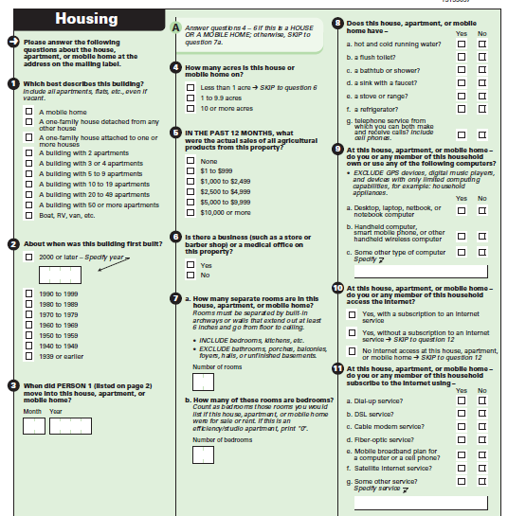
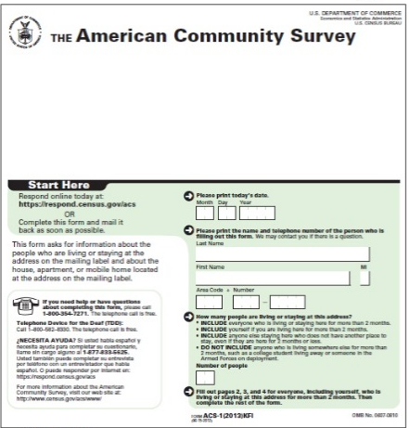
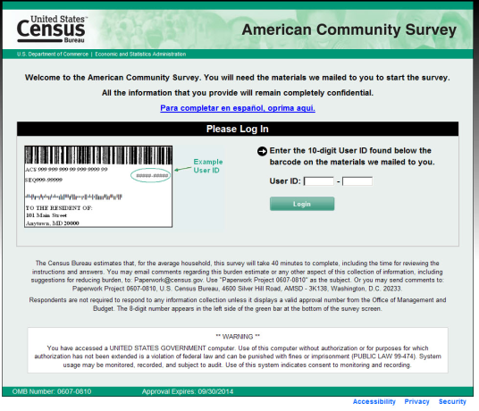
American Community Survey
Ongoing monthly survey sent to 3.5 million addresses per year to produce detailed population and housing estimates
Designed to produce critical information on small areas and small population groups previously collected on the decennial long form
Supports over 300 known Federal Government uses
April 2018

Slide 13
American Community Survey
Ongoing monthly survey sent to 3.5 million addresses per year to produce detailed population and housing estimates
Designed to produce critical information on small areas and small population groups previously collected on the decennial long form
Supports over 300 known Federal Government uses
Reports on more than 35,000 communities, 930,000 “geographic areas.”
April 2018

Slide 14




ACS Content
Social
Ancestry
Citizenship Status
Disability Status
Educational Attainment & School Enrollment
Fertility
Grandparents as Caregivers
Language Spoken at Home
Marital History; Marital Status
Migration/Residence 1 Year Ago
Period of Military Service
Place of Birth
Undergraduate Field of Degree
Veteran Status
Year of Entry
Demographic
Age
Hispanic or Latino Origin
Race
Relationship to Householder
Sex
Housing
Bedrooms
Computer and Internet Use
House Heating Fuel
Kitchen Facilities
Occupancy/Vacancy Status
Occupants Per Room
Plumbing Facilities
Rent
Rooms
Selected Monthly Owner Costs
Telephone Service Available
Tenure (Owner/Renter)
Units in Structure
Value of Home
Vehicles Available
Year Householder Moved In Year Structure Built
35+ Topics
Economic
Commuting (Journey to Work)
Place of Work
Employment Status
Food Stamps/SNAP
Health Insurance Coverage
Income and Earnings
Industry, Occupation
Class of Worker
Poverty Status
Work Status Last Year
1000+ Tables
11 Billion Estimates
April 2018

Slide 15

Census Bureau
Economic Programs
April 2018

Slide 16
Census Economic Surveys
Census Bureau Economic Surveys are a key source for official statistics companies can use:
April 2018

Slide 17
Monthly
and Quarterly
Surveys
Census Economic Surveys
Census Bureau Economic Surveys are a key source for official statistics companies can use:
  Monthly and Quarterly are small sample surveys that provide the most TIMELY data available
April 2018

Slide 18
Monthly
and Quarterly
Surveys
Annual Surveys
Census Economic Surveys
Census Bureau Economic Surveys are a key source for official statistics companies can use:
  Monthly and Quarterly are small sample surveys that provide the most TIMELY data available
  Annual surveys have larger samples and provide the most up-to-date TREND data available
April 2018

Slide 19
Monthly
and Quarterly
Surveys
Annual Surveys
Economic Census – Every 5 years
Census Economic Surveys
Census Bureau Economic Surveys are a key source for official statistics companies can use:
  Monthly and Quarterly are small sample surveys that provide the most TIMELY data available
  Annual surveys have larger samples and provide the most up-to-date TREND data available
  Every 5 years, the Economic Census measures all businesses and provides the most COMPREHENSIVE data available
April 2018

Slide 20
Monthly
and Quarterly
Surveys
Annual Surveys
Economic Census – Every 5 years
Census Economic Surveys
Census Bureau Economic Surveys are a key source for official statistics companies can use:
  Monthly and Quarterly are small sample surveys that provide the most TIMELY data available
  Annual surveys have larger samples and provide the most up-to-date TREND data available
  Every 5 years, the Economic Census measures all businesses and provides the most COMPREHENSIVE data available
These surveys set the standard for U.S. economic statistics, and are fueled by the data provided by individual businesses
April 2018

Slide 21
Census Economic Surveys
Additional Information
April 2018

Slide 22
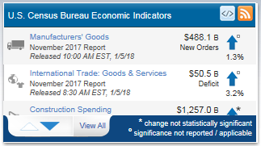
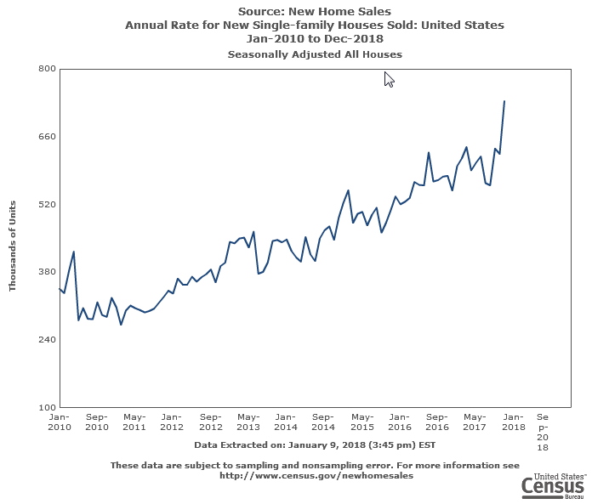
Economic Indicators
17 Census Bureau surveys that provide key economic statistics for nearly every sector
  Monthly, including:
    Retail Trade Survey, Building Permits, and Exports/Imports
  Quarterly Financial Report; Quarterly Services Survey
Sample surveys
Shown at the national level only, except:
  Building Permits/Housing Starts
  International Trade data
Released on the Economic Indicators Briefing Room: www.census.gov/economic-indicators/index.php
April 2018

Slide 23
International Trade
10 Census Bureau surveys that provide monthly and annual U.S. exports and imports statistics at the national, state, and port levels
Also provides data by Commodity Classification
  e.g. Beer and Ale sales across multiple industries (liquor stores, grocery stores, convenience, etc.)
Issues export regulations from the U.S.
See census.gov/foreign-trade/data/index.html
April 2018

Slide 24
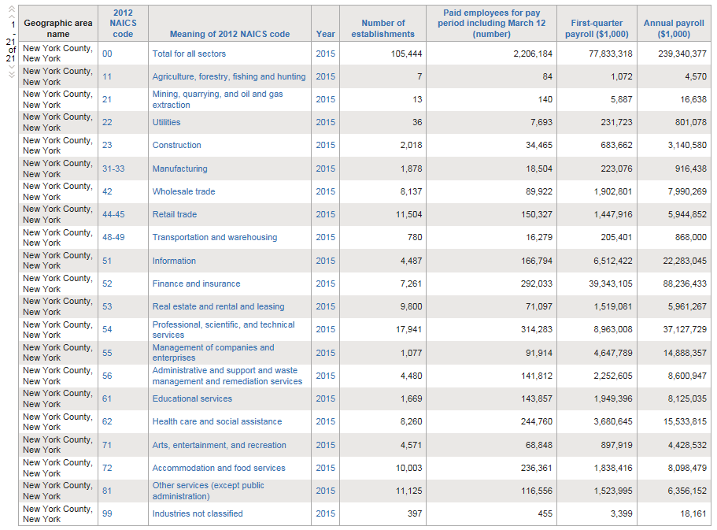
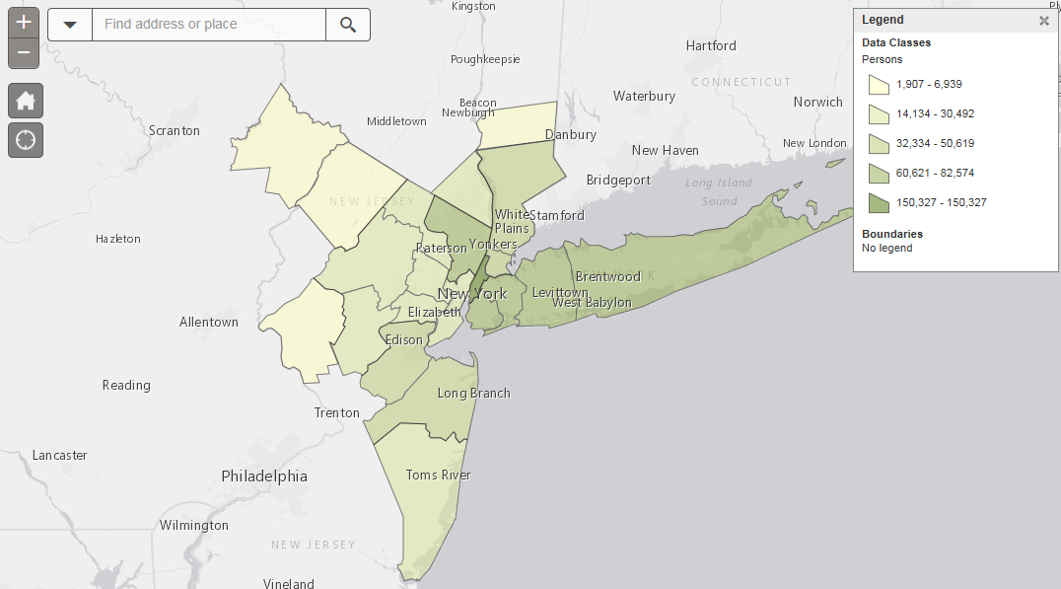
Annual Economic Programs
20 Census Bureau surveys that provide annual economic statistics for nearly every sector
Sample surveys or administrative data
Shown primarily at the national level, except:
  County Business Patterns: National, State, Metro, County, ZIP Code
  Non-Employer Statistics: National, State, Metro, County
  Annual Survey of Manufacturers: National and State
Other Related Annual Programs, including Retail eCommerce Sales (E-Stats) and Annual Capital Expenditures Survey
Released on American FactFinder, QuickFacts, Excel files, and other Census tools
April 2018

Slide 25
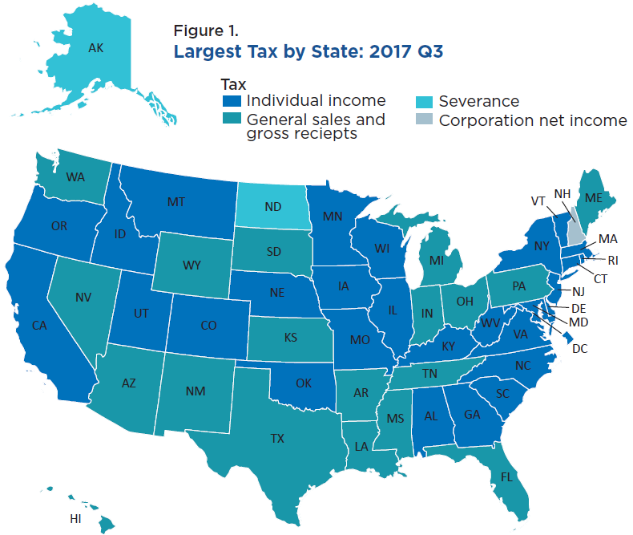
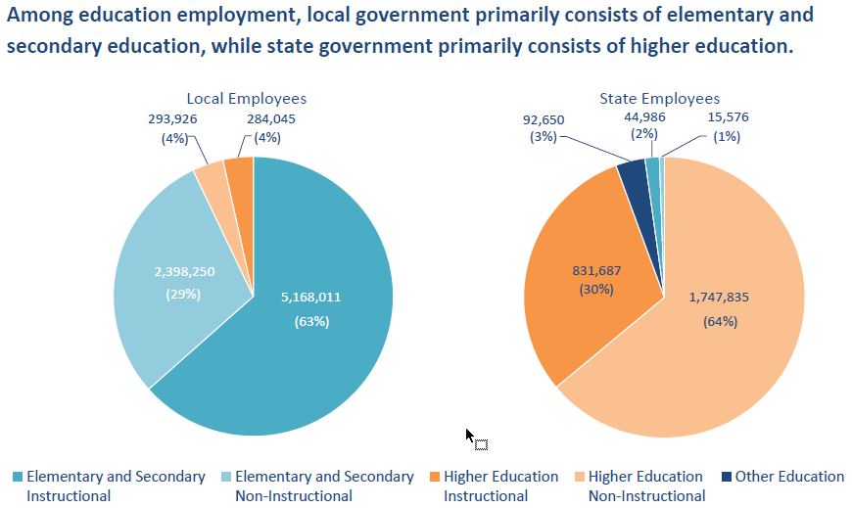
Public Sector (Governments)
5 surveys that provide economic statistics about state and local governments
Serve as public-sector counterpart to private sector data
Response is voluntary
Virtually no confidentiality restriction – data is public record
Core Program Content
  Organization and Structure
  Government Employment
  Government Finances
Released on American FactFinder, Excel files, and other Census tools
April 2018

Slide 26
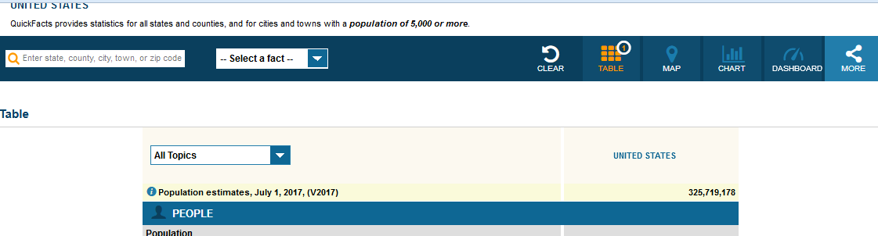
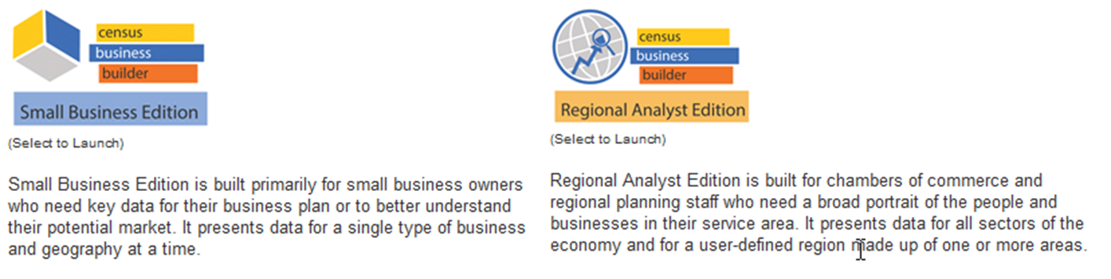

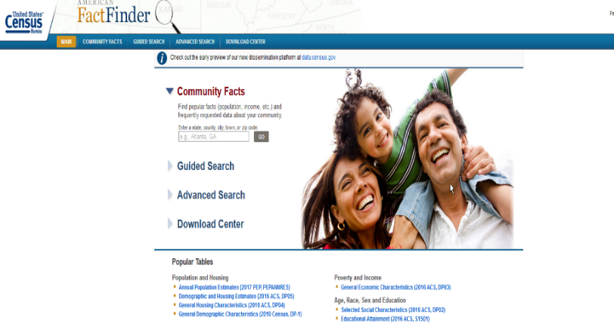
Census Bureau Data Tools
  QuickFacts – provides statistics for all states and counties, and for cities and towns with a population of 5,000 or more
  Census Business Builder (CBB) – a suite of services that provide selected demographic and economic data from the Census Bureau tailored to specific types of users in a simple to access and use format
  Industry Statistics Portal (ISP) – provides access to the Census Bureau programs that provide economic data for a user-selected industries
  American FactFinder (AFF) – American FactFinder provides access to data about the United States, Puerto Rico and the Island Areas. The data in American FactFinder come from several censuses and surveys
April 2018

Slide 27
Using Census Bureau
Statistics
April 2018

Slide 28
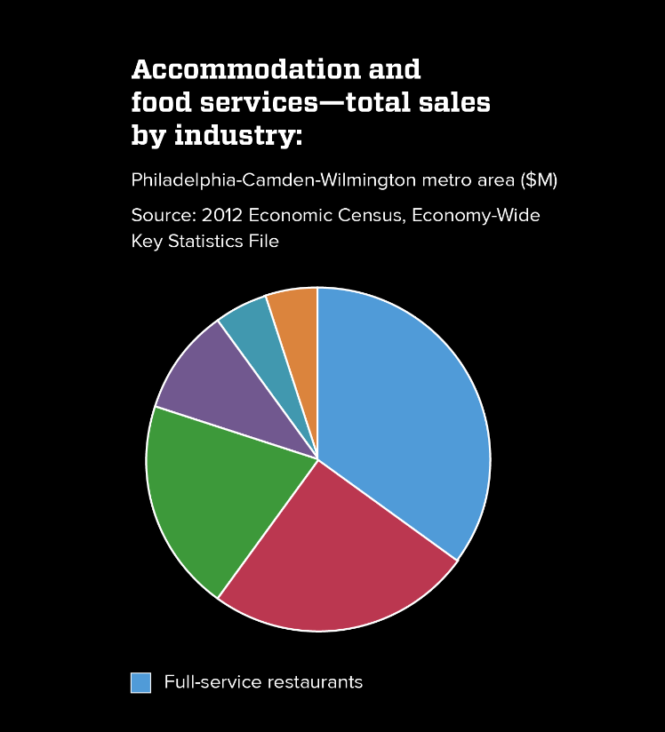
Using Census Bureau Statistics
When it was time for James to open his second restaurant, he used U.S. Census Bureau economic statistics to help pick the location – free and available online
April 2018

Slide 29
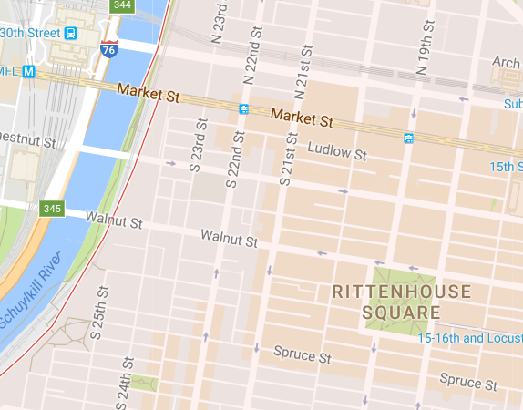
Using Census Bureau Statistics
When it was time for James to open his second restaurant, he used U.S. Census Bureau economic statistics to help pick the location – free and available online
With industry trends and zip code level data, he identified a downtown spot with high potential for growth
April 2018

Slide 30

Using Census Bureau Statistics
When it was time for James to open his second restaurant, he used U.S. Census Bureau economic statistics to help pick the location – free and available online
With industry trends and zip code level data, he identified a downtown spot with high potential for growth
Where did these statistics come from?
They came from James’ first restaurant and all the other companies who responded to Census Bureau surveys. Together, their data fueled the local, state, and national statistics used for planning and decision making.
April 2018

Slide 31

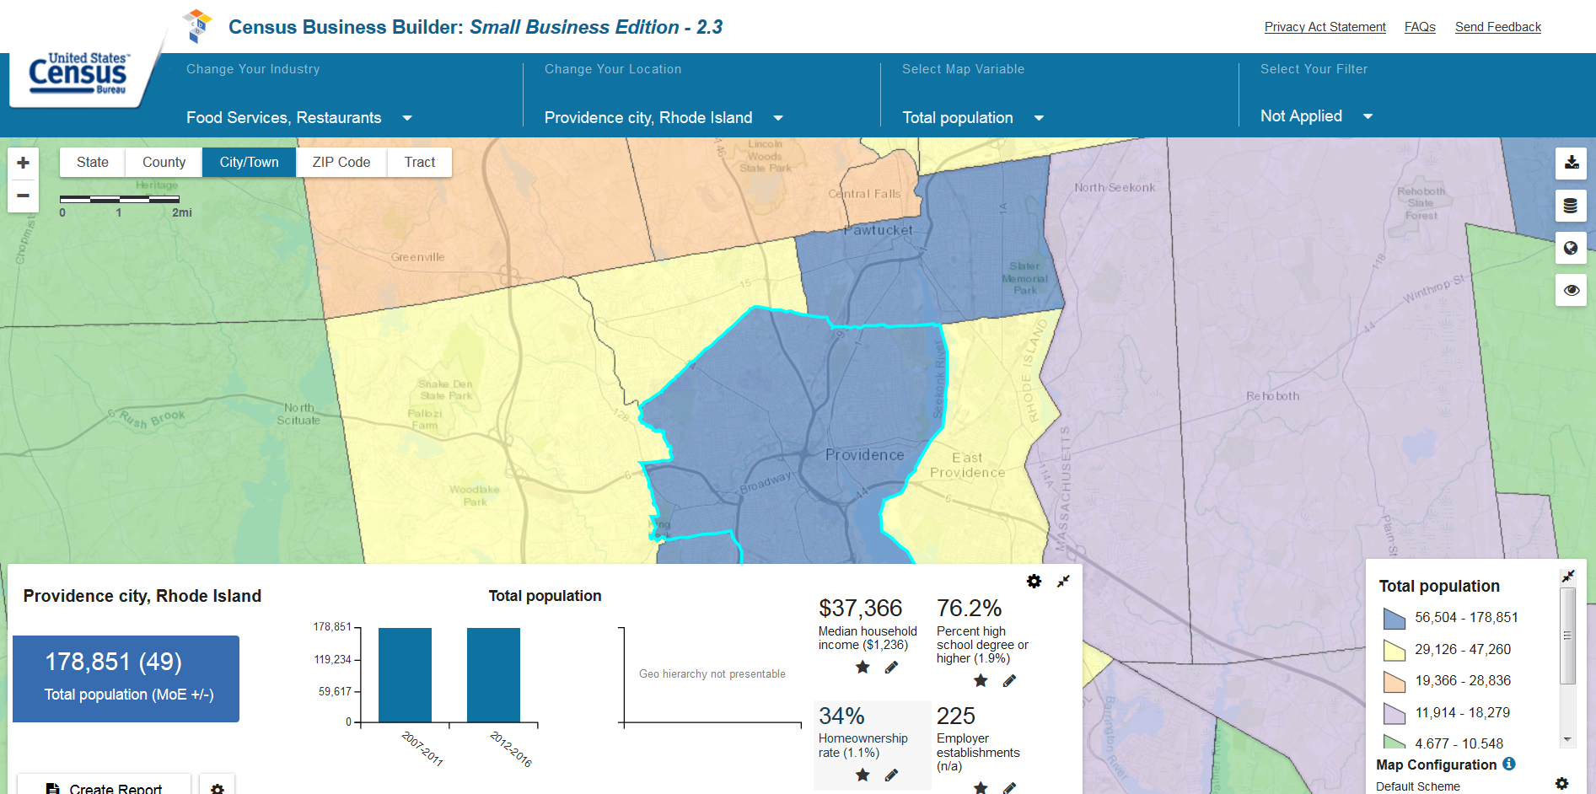
Census Bureau Economic Statistics – Providence, RI
Monthly and Quarterly data:
  Details
Annual data:
  Details
Economic Census 5-year data:
  Details
April 2018

Slide 32

Economic Census
Overview
April 2018

Slide 33

About the Economic Census
The U.S. Census Bureau measures the nation’s population once every 10 years. It also measures U.S. businesses every 5 years with the Economic Census
The next Economic Census is conducted in May 2018. Companies report their 2017 year-end numbers. Due Date is June 12th.
Response is required by law
Responses are confidential. Company data is used for statistical purposes only. The Census Bureau is required by law to keep your information private and secure
Response is required online. This reduces the time needed for completion, improves accuracy, and provides significant cost savings for taxpayers
Results from the Economic Census are free and available to guide business decisions and policy-making
April 2018

Slide 34
Information Required
The Economic Census asks for the following information by location
Employer Identification Number
Physical location
Primary business activity
Sales, receipts, or revenue
Employment and payroll
Industry-specific questions
April 2018

Slide 35
Economic Census Response
Program launches in May 2018
  Official letters mailed with web address and unique company code to access online survey
  Deadline for response is June 12, 2018
Respondents will be instructed to set up online account on secure website to complete survey
  New requirement for Census Bureau economic surveys
  Similar to other online accounts with email username, password, security questions
Key changes include
  Online response requirement, new reporting instrument for businesses with multiple locations, change in data collection timeframe
Help will be available online and via telephone
Information and resources are available at www.census.gov/EconomicCensus
April 2018

Slide 36

Communications to your Organization
Three dates to remember: “9-8-7”
April 2018

Slide 37
Communications to your Organization
Three dates to remember: “9-8-7”
9
April 9th
Communications campaign launches. Organizations asked to distribute Response Preparation informational email to membership.
April 2018

Slide 38
Communications to your Organization
Three dates to remember: “9-8-7”
9
8
April 9th
May 8th
Communications campaign launches. Organizations asked to distribute Response Preparation informational email to membership.
Official letters with online access codes are arriving at respondent businesses. Organizations asked to distribute email invitation to May 17th Webinar.
April 2018

Slide 39
Communications to your Organization
Three dates to remember: “9-8-7”
9
8
7
April 9th
May 8th
June 7th
Communications campaign launches. Organizations asked to distribute Response Preparation informational email to membership.
Official letters with online access codes are arriving at respondent businesses. Organizations asked to distribute email invitation to May 17th Webinar.
Organizations asked to distribute Due Date Reminder email to membership in advance of Economic Census response deadline – June 12th
April 2018

Slide 40
Communications to your Organization
Three dates to remember: “9-8-7”
9
8
7
April 9th
May 8th
June 7th
Communications campaign launches. Organizations asked to distribute Response Preparation informational email to membership.
Official letters with online access codes are arriving at respondent businesses. Organizations asked to distribute email invitation to May 17th Webinar.
Organizations asked to distribute Due Date Reminder email to membership in advance of Economic Census response deadline – June 12th
Details and emails to forward will be sent in the weeks prior to each date
Additional information and promotional materials are available for download at www.census.gov/EconomicCensus
April 2018

Slide 41





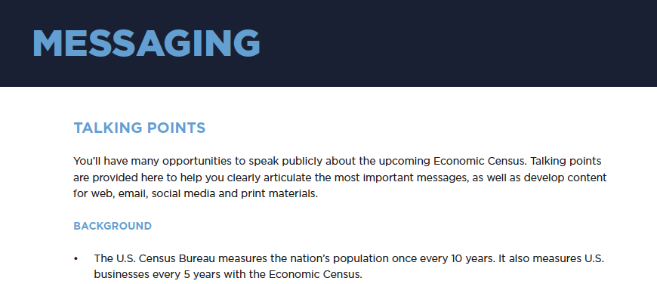

2018 Communications Campaign www.census.gov/EconomicCensus
April 2018
U.S. Census Bureau Briefing | February 2018 | 41

Slide 42

2018 Communications Campaign www.census.gov/EconomicCensus
April 2018

Slide 43
How You Can Help
You are your community’s trusted voice
Spread the word/Carry the message
Distribute materials
Be the boots on the ground
Promote the value of response
April 2018

Slide 44
Q & A
April 2018

Slide 45
Contact Us
Kimberly Moore
kimberly.p.moore@census.gov
301-763-7643
Chuck Brady
charles.f.brady@census.gov
301-763-6707
Angelo Bonaccorsy
angelo.j.bonaccorsy@census.gov
301-763-3039
April 2018

