Slide 1
Redistricting Data Program
James Whitehorne
Census Redistricting & Voting Rights Data Office

Slide 2
Redistricting Data Program
Mission: Provide the officers or public bodies having initial responsibility for the legislative apportionment or districting of each State an opportunity to identify the geographic areas for which specific tabulations of population are desired and to deliver those tabulations in a timely manner.
Requirements:
Establish program criteria
Identify required tabulations
Conduct the program in a non-partisan manner
Deliver the tabulations to the governor and the officers or public bodies having initial responsibility for the legislative apportionment or districting of each State no later than 1 year from Census Day (April 1, 2021)
Identified “geographic areas desired”:
Census Tabulation Blocks
Voting Districts (e.g. precincts, wards, etc.)
Legislative and Congressional Districts

Slide 3
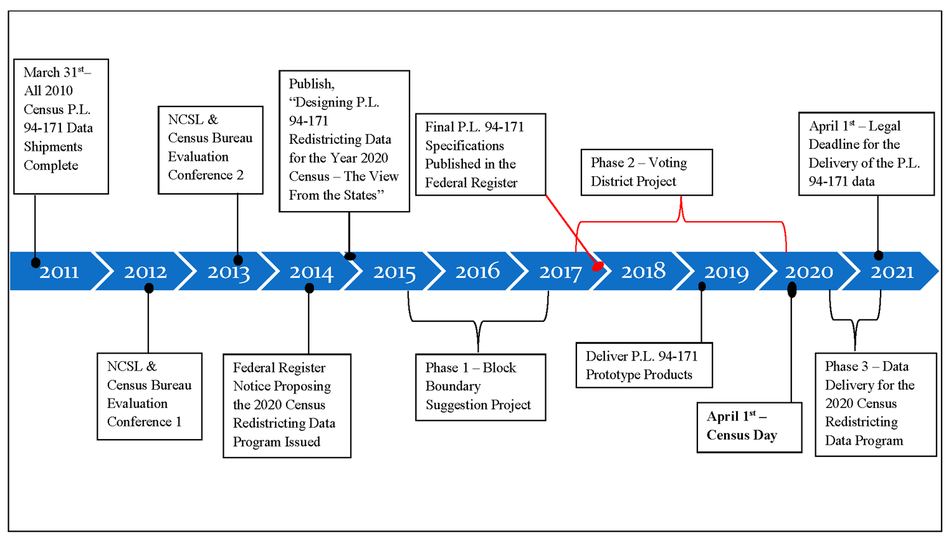
Redistricting Data Program

Slide 4
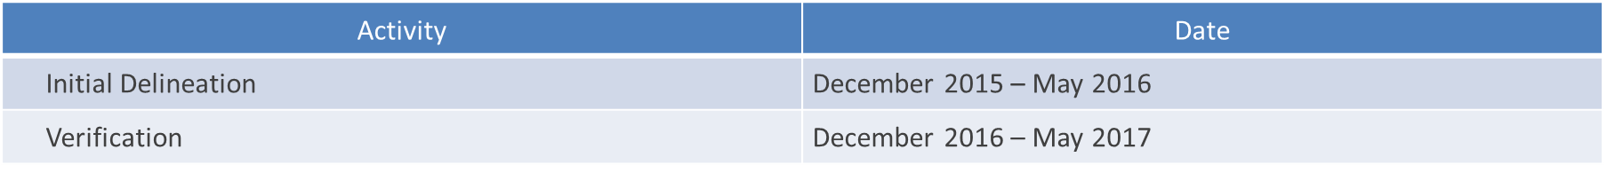
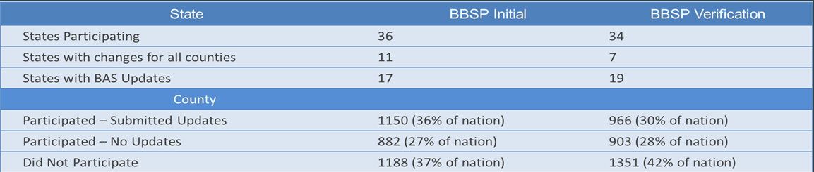
Redistricting Data Program
Phase 1 – Block Boundary Suggestion Project (BBSP)
Phase 1 - BBSP Participation

Slide 5
Redistricting Data Program
Phase 2 – Voting District Project (VTDP)
Activity | Date
Initial Delineation | December 22, 2018 – May 31, 2018
Verification I | January 2, 2019 – May 31, 2019
Verification II* | January 2, 2020 – March 31, 2020
*Added a short second round of verification for those states who participate in both the Initial Delineation and the first round of Verification

Slide 6
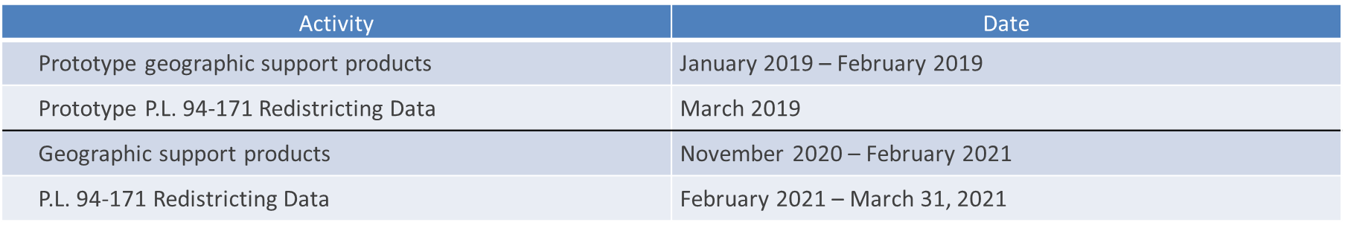
Redistricting Data Program
Phase 3 – Data Delivery
Geographic Support Products
Shapefiles
Maps (PDF only)
Block Assignment Files
Block to Block Relationship Files

Slide 7
Redistricting Data Program
Phase 3 – Data Delivery (continued)
P.L. 94-171 Redistricting Data
2018 Prototype P.L. 94-171 Redistricting Data File
Table P1 – Race
Table P2 – Race for the Population 18 Years and Over
Table P3 – Hispanic or Latino, and not Hispanic or Latino by Race
Table P4 – Hispanic or Latino, and not Hispanic or Latino by Race for the Population 18 and Over
Table H1 – Occupancy Status (Housing)
New Table
Table P42 – Group Quarters Population by Group Quarters Type

Slide 8
Redistricting Data Program
Phase 3 – Residence Criteria and Situations
Situations of most interest to Redistricting:
Federally Affiliated Count Overseas
  Military Overseas Enumeration
    Deployed vs Stationed
Correctional Facilities
  Group Quarters on the P.L. 94-171 File
  Proposed product/service from the FRN

Slide 9
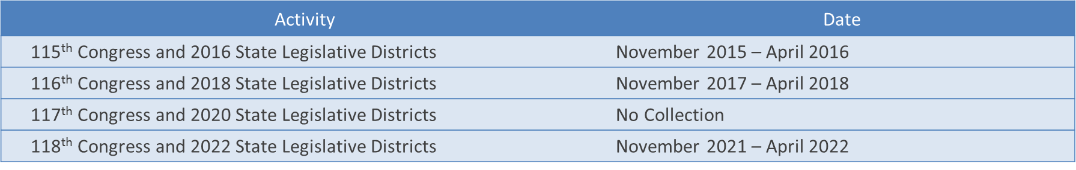
Redistricting Data Program
Phase 4 – Congressional and State Legislative Districts Collection
117th Congress and 2020 State Legislative Districts
Evaluating need and ability to collect these changes should many happen between April 2018 and November 2019
No retabulation or other products produced due to proximity to the decennial census.

Slide 10
Redistricting Data Program
Milestones
Activity | Date
FRN announcing the 2020 Census Redistricting Data Program | July 15, 2014 | ✓
Publish “The View From the States” for the 2020 Census | January 5, 2015 | ✓
Establish 2020 Redistricting Data Program liaisons | April, 2015 to February, 2016 | ✓
FRN announcing Phase 1 – Block Boundary Suggestion Project (BBSP) | June 26, 2015 | ✓
BBSP Invitation to participate | August 31, 2015 | ✓
Collect boundaries for the 115th Congress and 2016 State Legislative Districts | November, 2015 to April, 2016 | ✓
BBSP Completed | July 31, 2017 | ✓
FRN announcing Phase 2 – Voting District Project (VTDP) | June 28, 2017 | ✓
VTDP Invitation to participate | September 29, 2017 | ✓
FRN for comment on prototype data design from 2018 Census Test | October, 2017 | ✓
Collect boundaries for the 116th Congress and 2018 State Legislative Districts | November, 2017 to April, 2018 | ✓
FRN final prototype data design from 2018 Census Test | April, 2018 | ✓
Deliver prototype data and geographic files from the 2018 Census Test | March, 2019
VTDP Completed | March, 2020
Deliver official P.L. 94-171 Redistricting Geographic Files | November, 2020 to February, 2021
Deliver official P.L. 94-171 Redistricting Data Summary Files | February, 2021 to March, 2021

Slide 11
Questions?

