Slide 1


2020 Census
Preparations and Partnership
State Data Center Annual Training Conference
April 9, 2018

Slide 2
Census Preparation - Foundation
One Census Partnership Specialist; One Data Dissemination Specialist covering North Carolina and South Carolina
In general, No State Census Budget
NC SDC – 1 lead person/agency, 3 cords, 41 affiliates including:
NC League of Municipalities
NC Association of County Commissioners
16 Councils of Government (Lead Regional Organizations)
10 Public Libraries
Direct SDC Lead Roles – Governor’s Liaison, Census Redistricting Co-Liaison, Statewide LUCA Reviewer, NC Geographic Information Coordinating Council (GICC) Census Working Group Chair

Slide 3
NC SDC Goals
Maintain consistent contact between Census HQ, Census Regional Office, and State – consistent messaging and coordinate timing with local governments
Develop statewide Census promotion plan
Raise awareness of Census preparation operations with local governments and connect them with statewide contacts

Slide 4
NC SDC Goals
Maintain consistent contact between Census HQ, Census Regional Office, and State – consistent messaging and coordinate timing with local governments
Support and promote NC SDC affiliates as local 2020 Census information and training resources to everyone but especially to local governments
Get 2020 Census preparations “on the radars” of local governments through web sites, listservs, and partner mailings
Use League of Municipalities and Association of County Commissioners’ leadership, meetings, and communication networks
Work with executive staff to form statewide CCC and Census promotion strategies

Slide 6
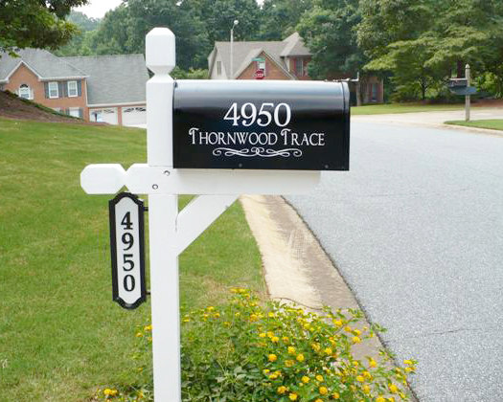
Local Update of Census Addresses (LUCA)
11 local informational workshops in
Spring 2017
16 local training sessions completed from
October 2017 – January 2018 hosted
by NC SDC COG affiliates
Training presentation available online
https://www.osbm.nc.gov/luca-training-north-carolina
Demo of Geographic Update Partnership (GUPS) software available at NC Census YouTube Channel
https://www.youtube.com/channel/UCZlm339foH_sjwc09NAMxSA

Slide 7
LUCA Preparation
87% County Participation in LUCA
Significant improvement from 2010 LUCA
Local COG outreach, hosting, and support throughout LUCA was welcome by county and municipal staff.
Keeping the local partners informed and supported is VITAL.
Statewide address resource responds to GSSI and will support statewide LUCA response.
Long Term Priority
Utilize AddressNC (statewide address resource) to support Census preparation, prepare for E-911 and other state agency and State Demographer needs, reduce reporting burden
Notes:
Many municipal governments signed on to work with their Counties to verify addresses. So we had better “Buy in.”
Folks liked knowing there was a local face/voice they could turn to with questions. There’s a lesson for partnership/promotion time!

Slide 8
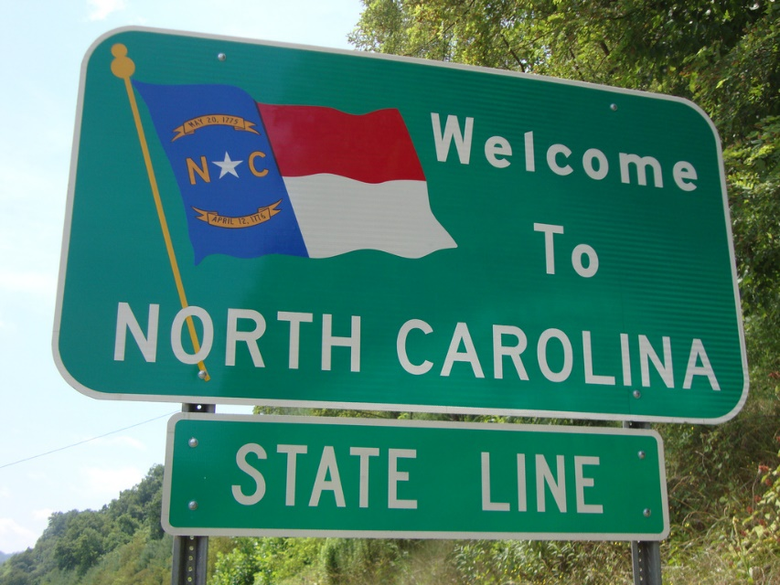
Boundary Annexation Survey (BAS)
NC SDC conducts BAS NRFU but is not
the BAS certifying entity in NC.
Included NC BAS certifier in all
2020 Census geographic planning
March/April non-response follow-up
North Carolina BAS workshops held this week:
Wilmington, February 12
Durham, February 13
Charlotte, February 14

Slide 9
Boundary Preparation
BAS non-response – The Usual Offenders
The GICC was a great resource for keeping state geospatial partners informed of Census preparations
Consistent messaging and local support have created more comfort with BAS, other Census prep programs, and the GUPS software
Long Term Priority
Improve statewide boundary resource (BoundaryNC?) to support Census, state agency, and State Demographer needs and reduce reporting burden.

Slide 10
Complete Count Committees
Supported Regional Office meetings with HEOs providing state support for Census participation
NC SDC Lead attended meeting with Census Director and team and NC Governor Cooper
Regular discussions with executive staff on statewide CCC development
Lots of questions about CCC formation
Census Planning Database
Response Outreach Area Mapper (ROAM)
Census Engagement Navigator
Developing local maps and visualizations

Slide 11
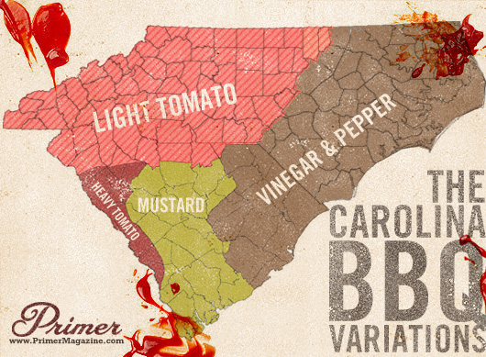
Contact
Bob Coats
(919) 807-4781
Bob.Coats@osbm.nc.gov
North Carolina State Data Center, Coordinator
Governor’s Census Liaison
Demographic and Economic Analysis Section
NC Office of State Budget and Management

