Slide 1

2020 Census
Mobile Questionnaire Assistance

Slide 2

Mobile Response Initiative and MQA
Census Bureau responded to the Joint Explanatory Statement for the Census Bureau’s 2019 appropriation by proposing a “Mobile Response Initiative.” The Mobile Response Initiative incorporates the use of technology to provide readily accessible ways for people to respond to the Census.
Mobile Questionnaire Assistance (MQA) is being developed for the Mobile Response Initiative.
MQA is a field initiative in which Census staff work closely with community organizations and local governments to go directly into neighborhoods, visit events, resident gatherings, and high traffic areas with Census-issued mobile devices.
Augments self-response efforts by providing additional accessibility for people to easily respond to the 2020 Census.

Slide 3
MQA Leveraging 2020 Innovations
The MQA Initiative allows us take advantage of new technologies in the 2020 census.
In 2010, QACs and Be Counted locations could not accept completed paper questionnaires. MQA is a model that secures a response on the spot.
MQA takes advantage of possibilities inherent in the 2020 innovations, e.g., the ability to remove self-response households even after NRFU starts.
MQA allows the Census Bureau to be nimble, to adapt to changing conditions as we monitor response. It compliments our existing plans for campaign optimization (adjusting digital resources in response to changing conditions).

Slide 4

Dynamic Deployment of Census Staff
The Census Bureau is working with partners, across the U.S., to identify key locations with prominent visibility in areas with low self-response rates. Possible locations include grocery stores and markets, houses of worship before and after services, community festivals, public transit hubs, libraries, community centers, and other locations where people naturally congregate.
In late March, initial MQA locations will be based on 2020 projected self-response rates. The areas with the lowest projected response rates have been identified for MQA. Beginning in Mid-April, the Census Bureau will start identifying on a weekly basis MQA locations based on actual response rates.
This ability to target resources towards areas experiencing lower response rates dynamically is one of the benefits of MQA.

Slide 5
A Role for Partners
Partnership Specialists will work with Complete Count Committees, state and local officials, and local partners to identify initial locations and events in historical low responding areas.
Local partners can help us identify high-priority areas in low responding areas to engage with the community.
They can also welcome Census staff working MQA at local and community events.
Some local and national partners may choose to set up Partner Questionnaire Assistance Centers, locations where respondents can access computer terminals to respond to the 2020 Census, view or pick up promotional materials, or get their questions answered by staff from the local partners. (The Census Bureau has established a Do’s and Don’ts Guide for establishing Partner QACs.)
Remember –
Partners are free to set up their own QACs staffed by partner personnel.
Just be clear that the Partner QAC
is not staffed with Census Bureau personnel.

Slide 6

Staffing
More than 4,000 Recruiting Assistants will convert into Census Response Representatives (CRRs). CRRs will support the ACOs that have tracts identified as low response. The CRRs will be responsible for attending MQA events. Other staff will also be retained, and some new staff will be hired.
Training for staff on MQA will begin in February for some positions. Census Response Representatives will be trained in March.
CRRs will be identifiable by CRR uniform consisting of a teal 2020 Census polo shirt and an ID badge that includes: their name, their photograph, a Department of Commerce watermark, and an expiration date. They will also have an official bag and Census Bureau issued tablet bearing the Census Bureau logo. Locations will be identifiable with banners bearing the 2020 Census logo.

Slide 7
Identification of Locations
Initial locations during the first few weeks of MQA will be in tracts with the lowest projected response rates. Partnership Specialists will review events and activities planned in these tracts to identify those that are best suited for MQA. Recruiting Managers will review the list of MQA events for their area census office (ACO) and will schedule Census Response Representatives (CRRs). When feasible, CRRs will be scheduled to work in MQA locations where they can support a necessary language for that community.
Beginning in Mid-April, the Census Bureau will start identifying on a weekly basis MQA locations based on actual response rates. The tracts with the lowest actual response rates will be identified. Partnership Specialists will again review events and activities planned in these tracts to determine those best suited for MQA. If no events are currently planned then Partnership Specialists will work with local partners to establish a new event. Recruiting Managers will then review the MQA events for their ACO and will schedule the CRRs.

Slide 8
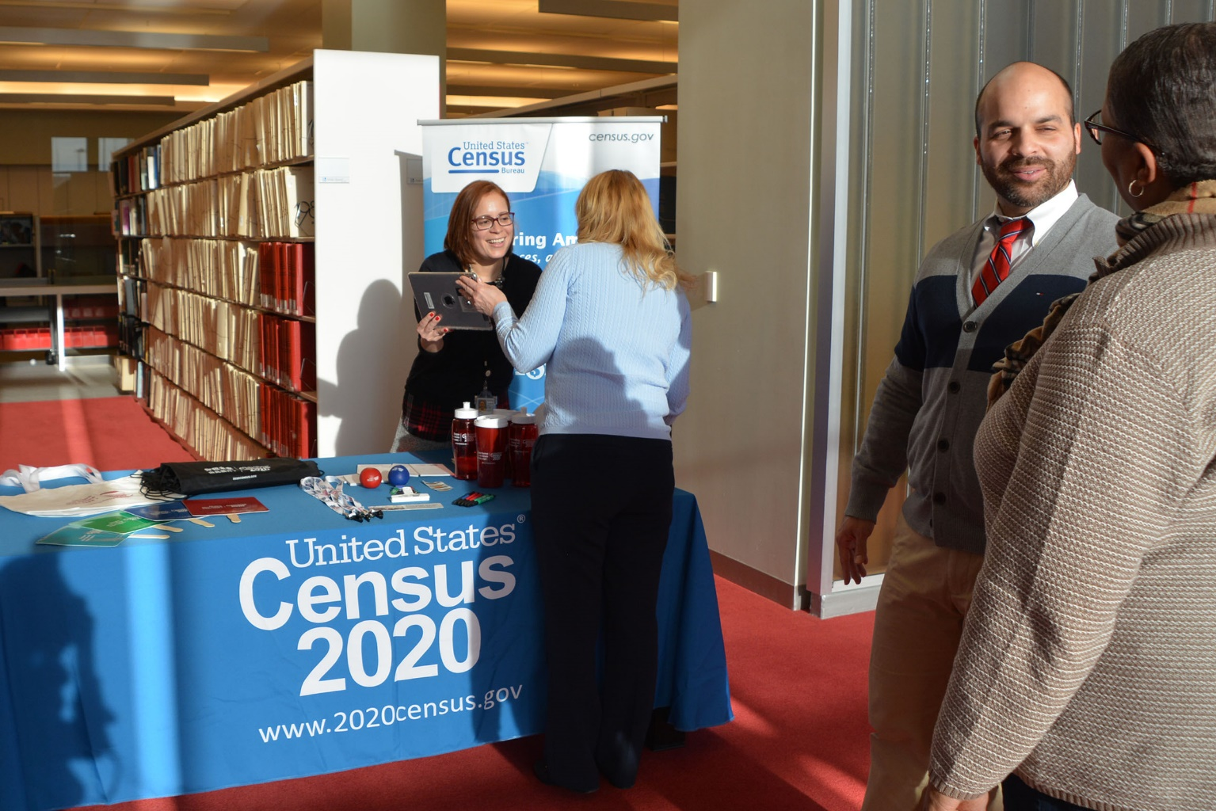
MQA Event Logistics
CRRs will bring their tablets and will use them to allow respondents to fill out the census on the Internet (both ID and non-ID responses). In addition, respondents will have the option to use their own devices to respond by typing in a URL that will be printed on materials the CRR will bring to the events. The ability for respondents to use the CRR’s tablet or their own device to respond will be dependent on Wi-Fi or cellular connectivity at the location.
The CRRs will have language assistance guides and access to language support via the 2020 Census web site. In addition, CRRs can direct respondents to the Census Questionnaire Assistance telephone line.

Slide 9
Timing
Initial MQA events scheduled for the first two weeks of operations
Soft Launch with a few CRRs
Full Production of MQA
Begin weekly cadence of identifying MQA locations based on actual response data
Work concludes at the conclusion of NRFU
End Feb/Early March
Week of 3/24
Week of 3/30
Mid-April
July

Slide 10

How to Connect with a Local Partnership Specialist
Atlanta
Phone: 470-889-6530
E-mail: Atlanta.rcc.partnership@2020census.gov
Chicago
Phone: 312-579-1605
E-mail: Chicago.rcc.partnership@2020census.gov
Dallas
Phone: 972-510-1530
E-mail: Dallas.rcc.partnership@2020census.gov
Los Angeles
Phone: 213-314-6230
E-mail: Los.Angeles.rcc.partnership@2020census.gov
New York
Phone: 212-882-2130
E-mail: New.York.rcc.partnership@2020census.gov
Philadelphia
Phone: 267-780-2530
E-mail: Philadelphia.rcc.partnership@2020census.gov

